Slide 1

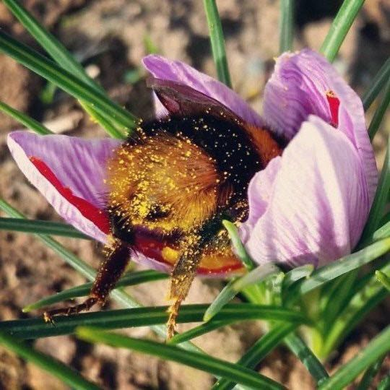
Beeyond
The Beehive
Sarah Sprole
Camilla Bahr
Subhra Nandi

Slide 2

Let’s Bee Informed
Most honey bees are kept by beekeepers in colonies or managed hives
1/3 of the food we eat is the result of honey bee pollination
We are able to wear cotton because the cotton plants our threads came from were pollinated
Honey bee population decline is caused by a number of stressors - from loss of habitat to mites to exposure to pesticides and diseases

Slide 3
Data Source
We collected data on honeybee colonies from the USDA Economics, Statistics and Market Information System website
https://usda.library.cornell.edu/concern/publications/rn301137d?locale=en
CSVs for Jan 2015 through June 2018
Alaska, Delaware, Nevada, New Hampshire, and Rhode Island were not published to avoid disclosing data for individual operations

Slide 4
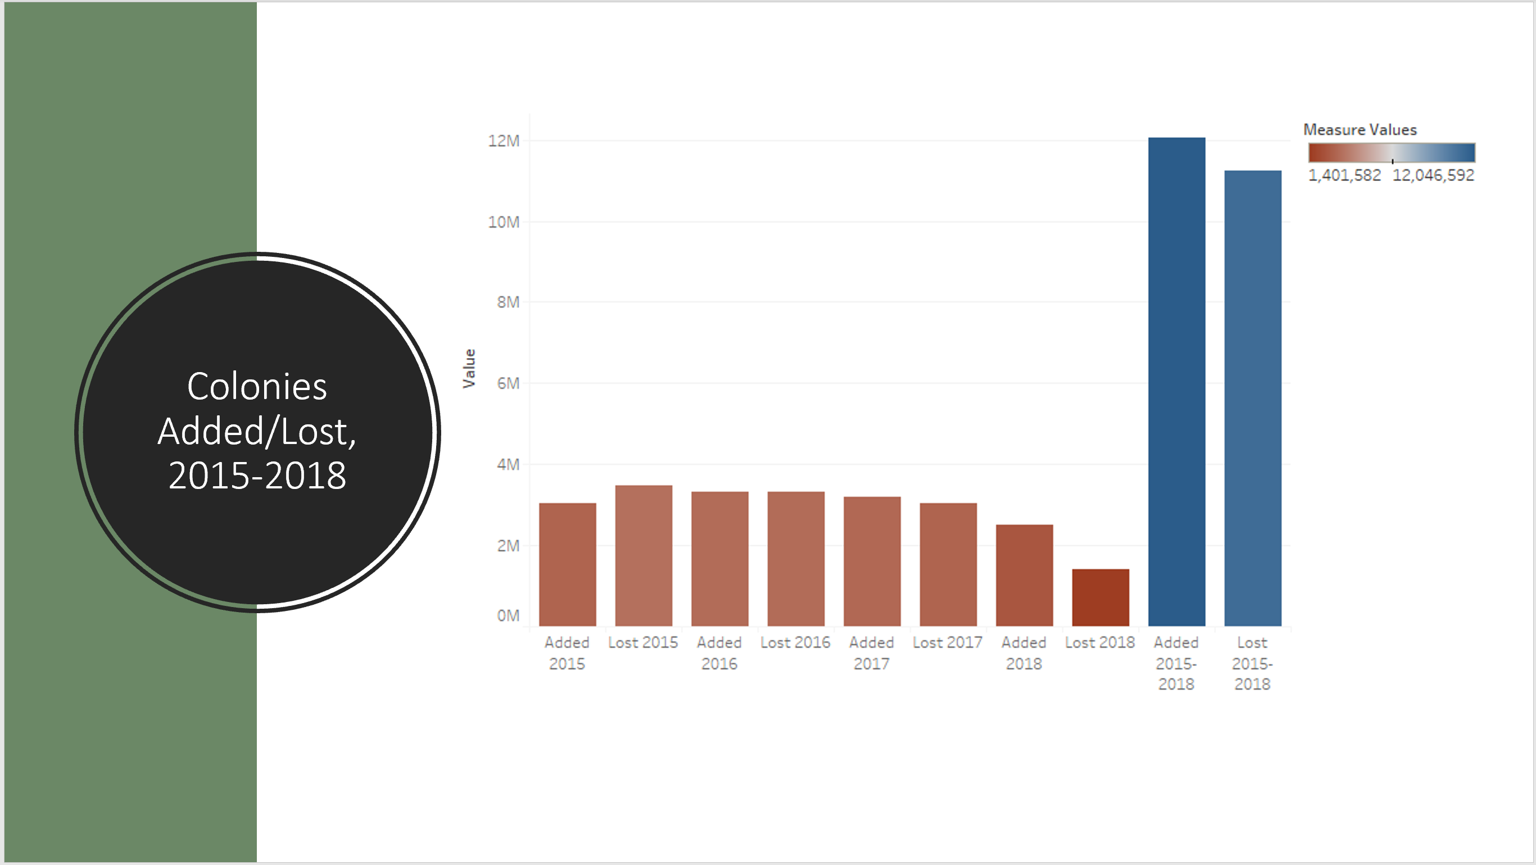

Slide 5
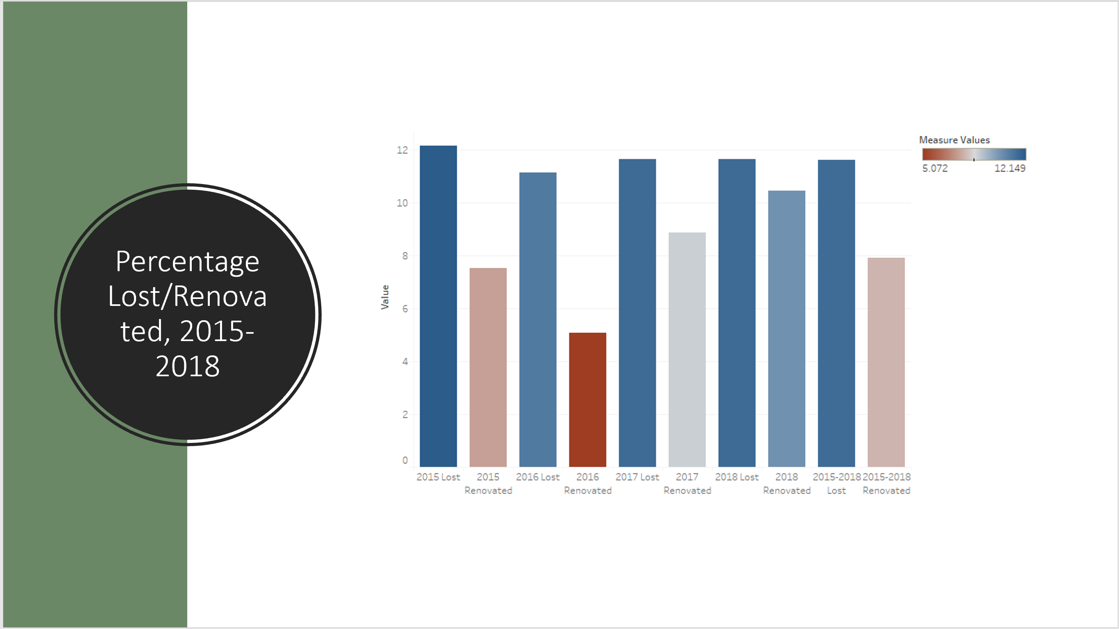

Slide 6
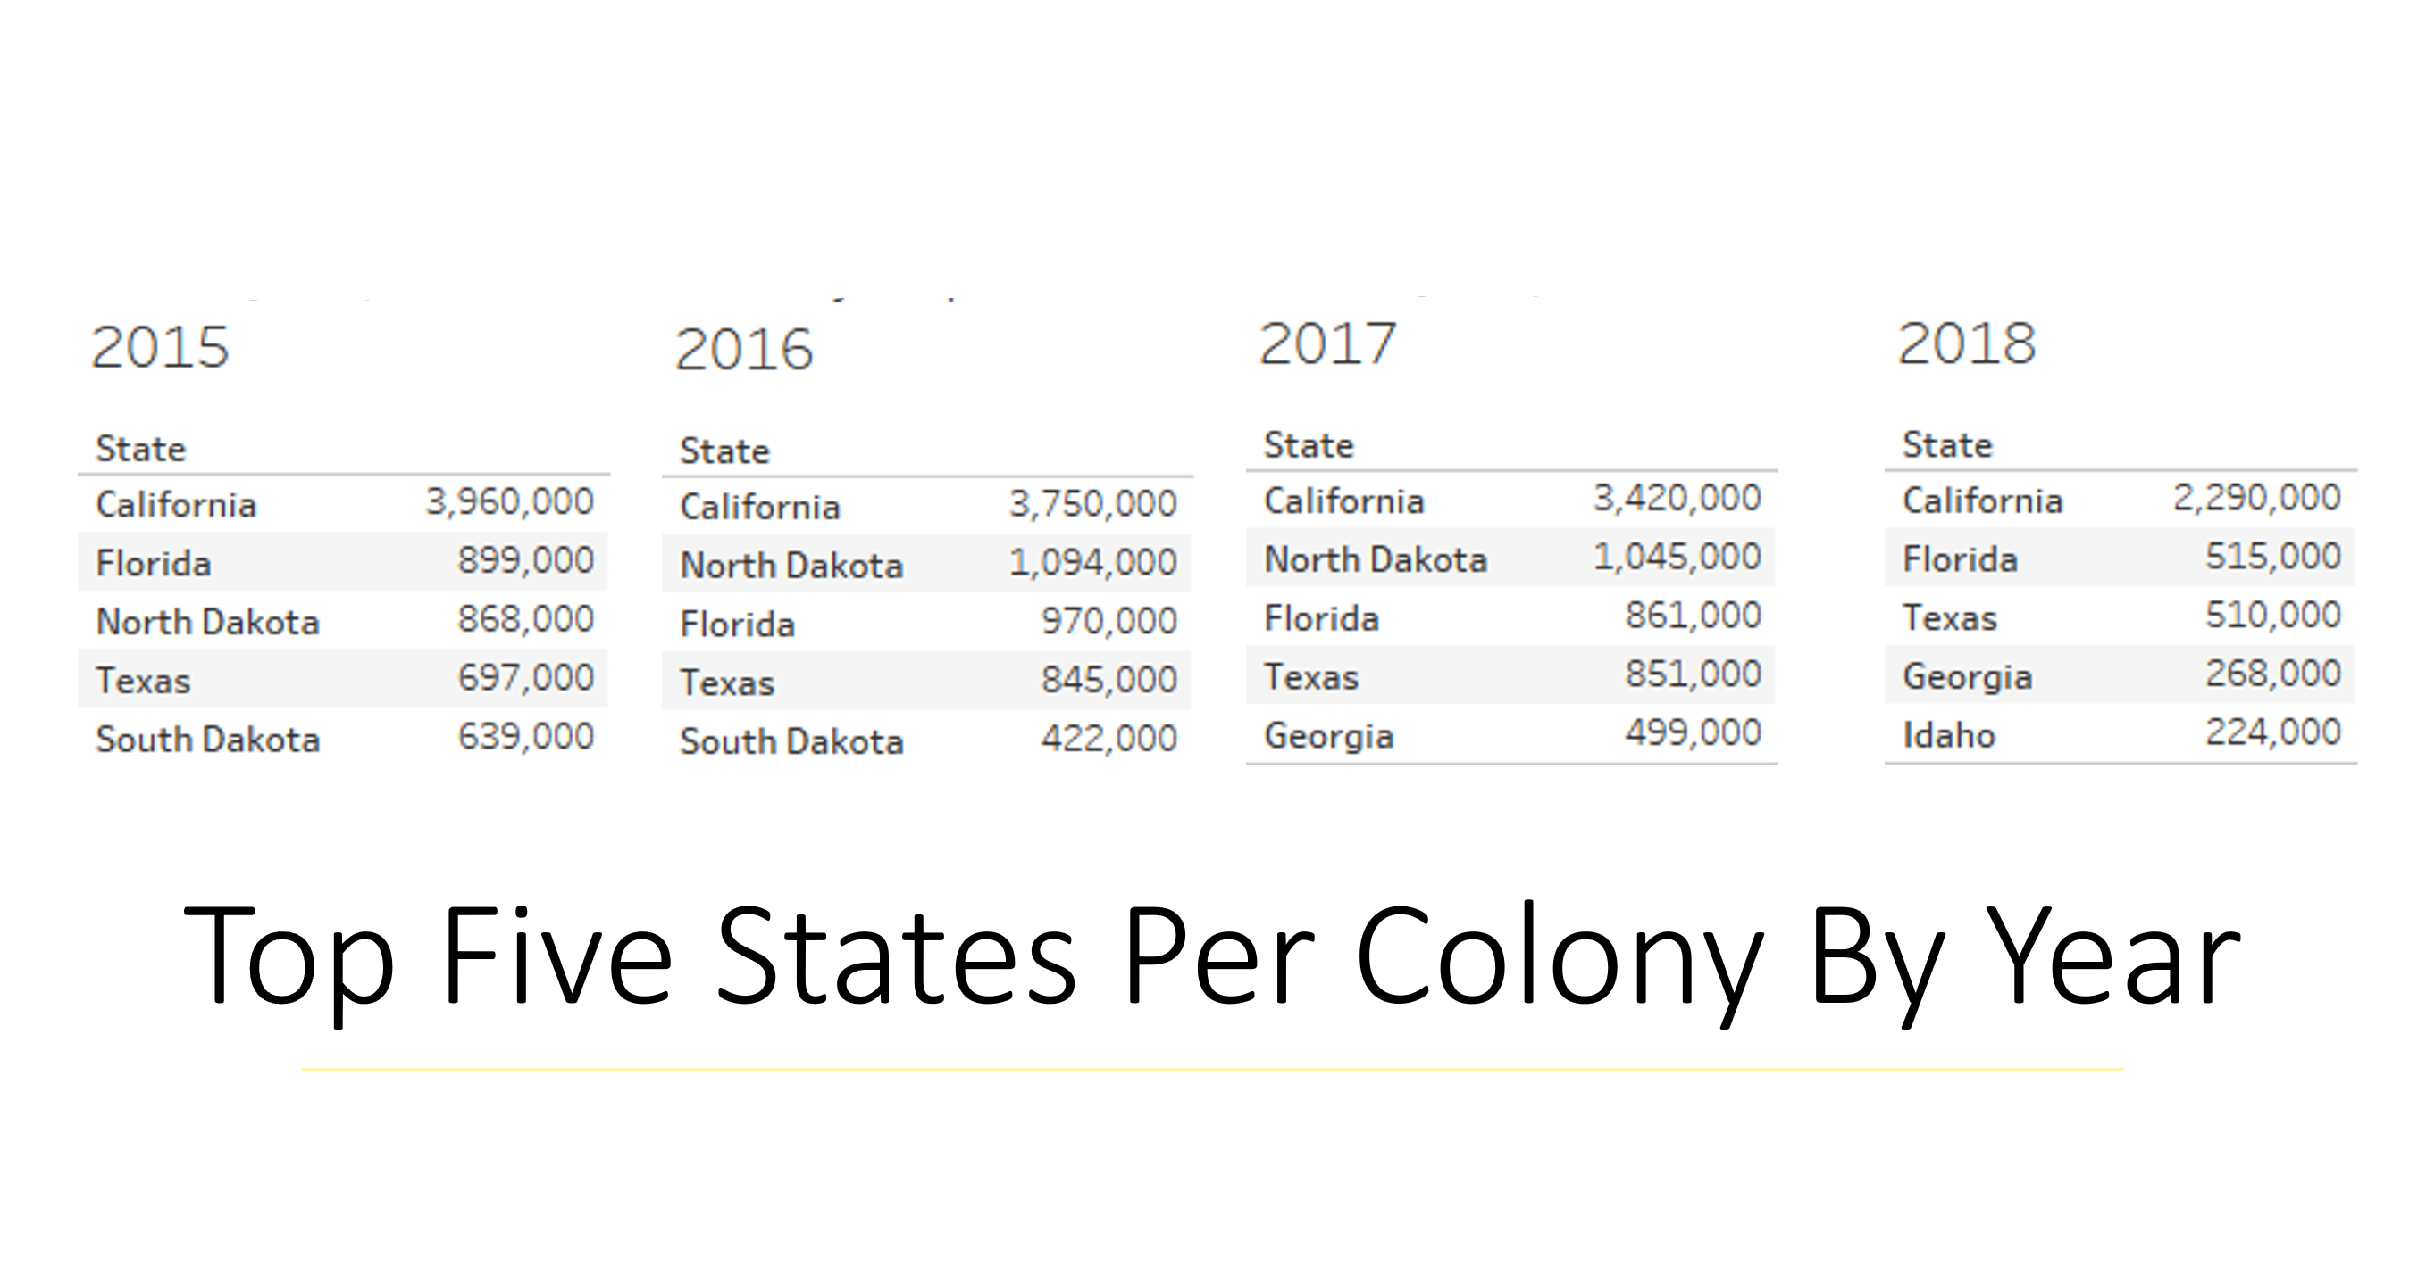

Slide 7
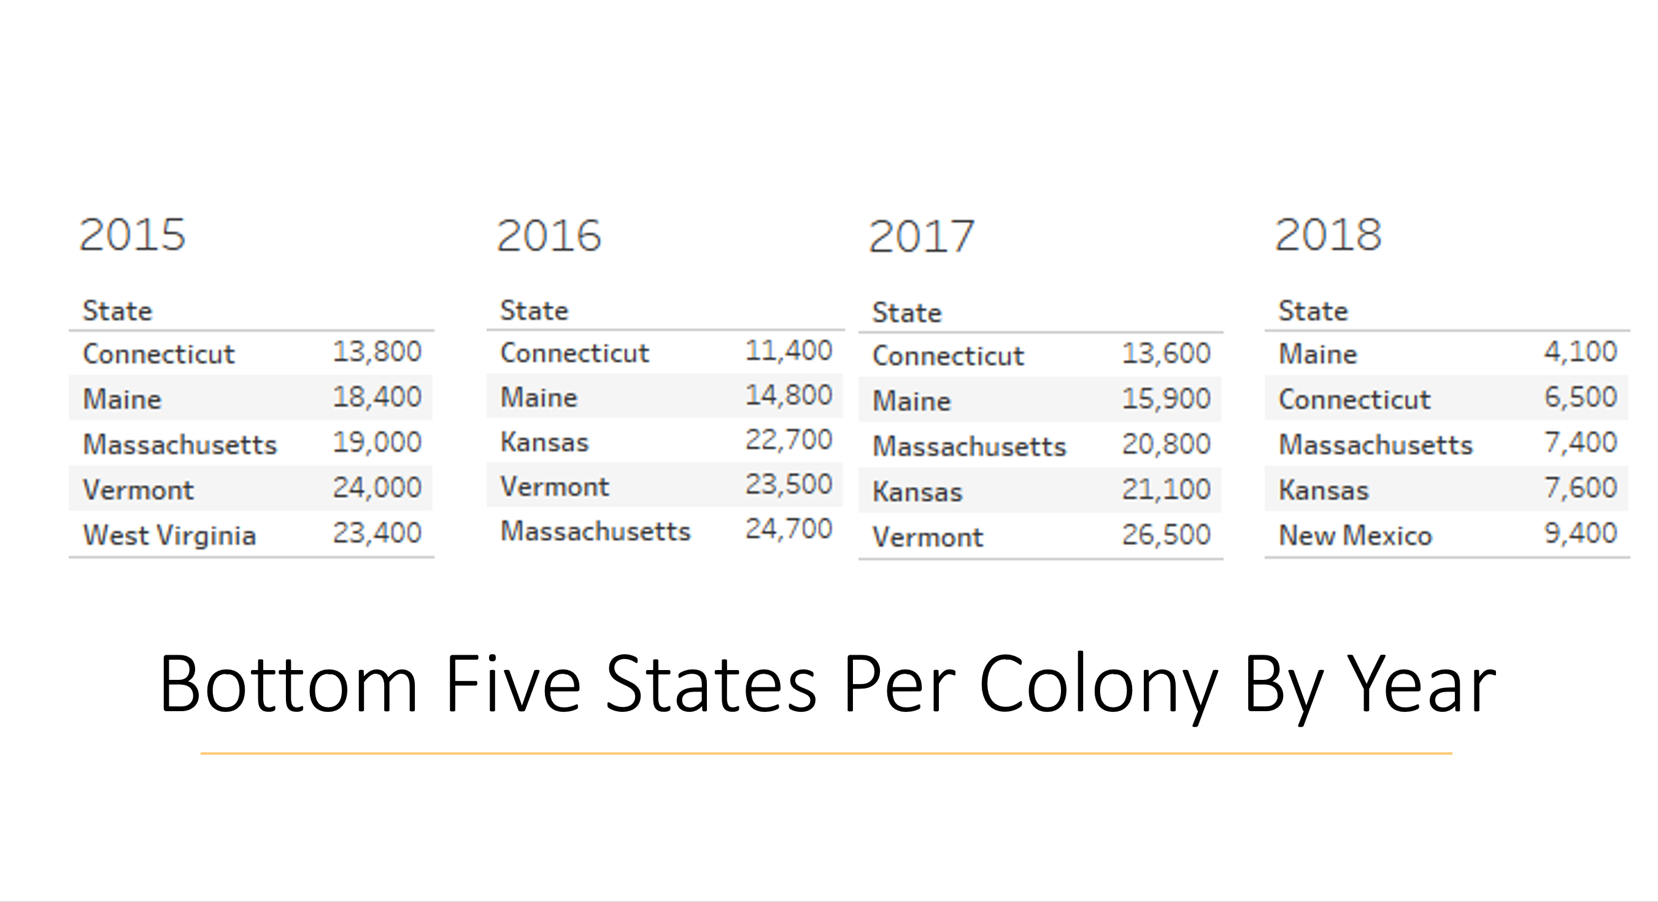

Slide 8
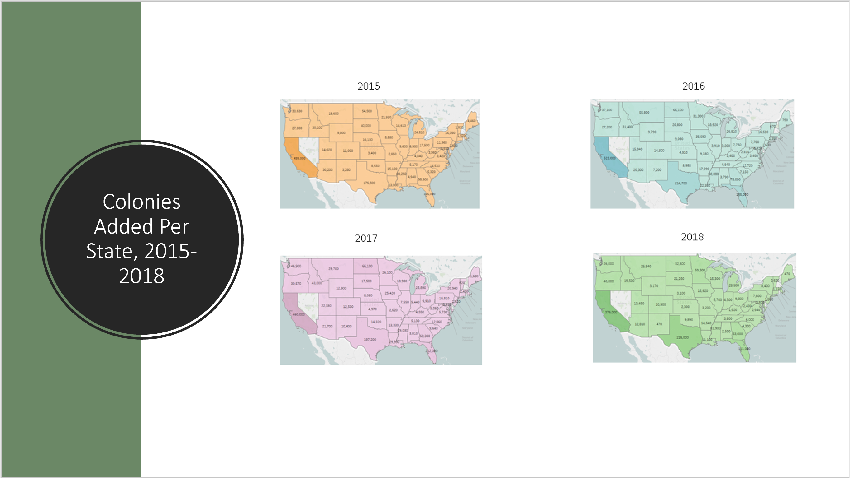

Slide 9
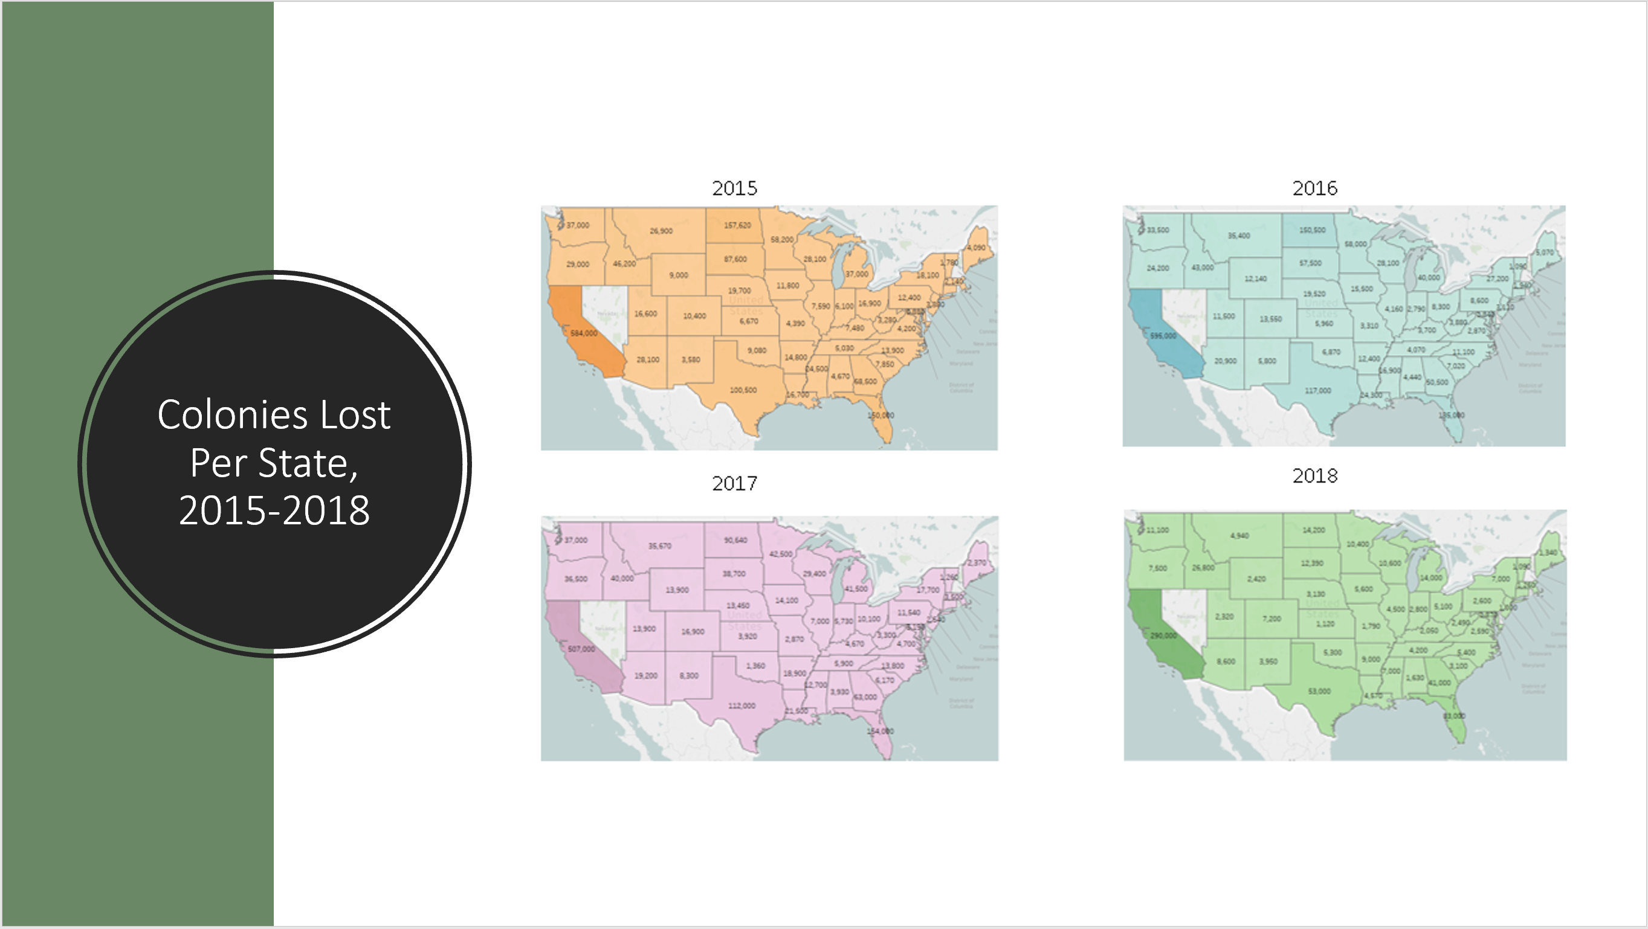

Slide 10
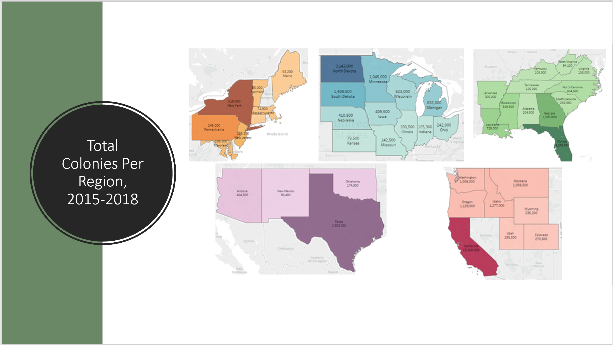

Slide 11
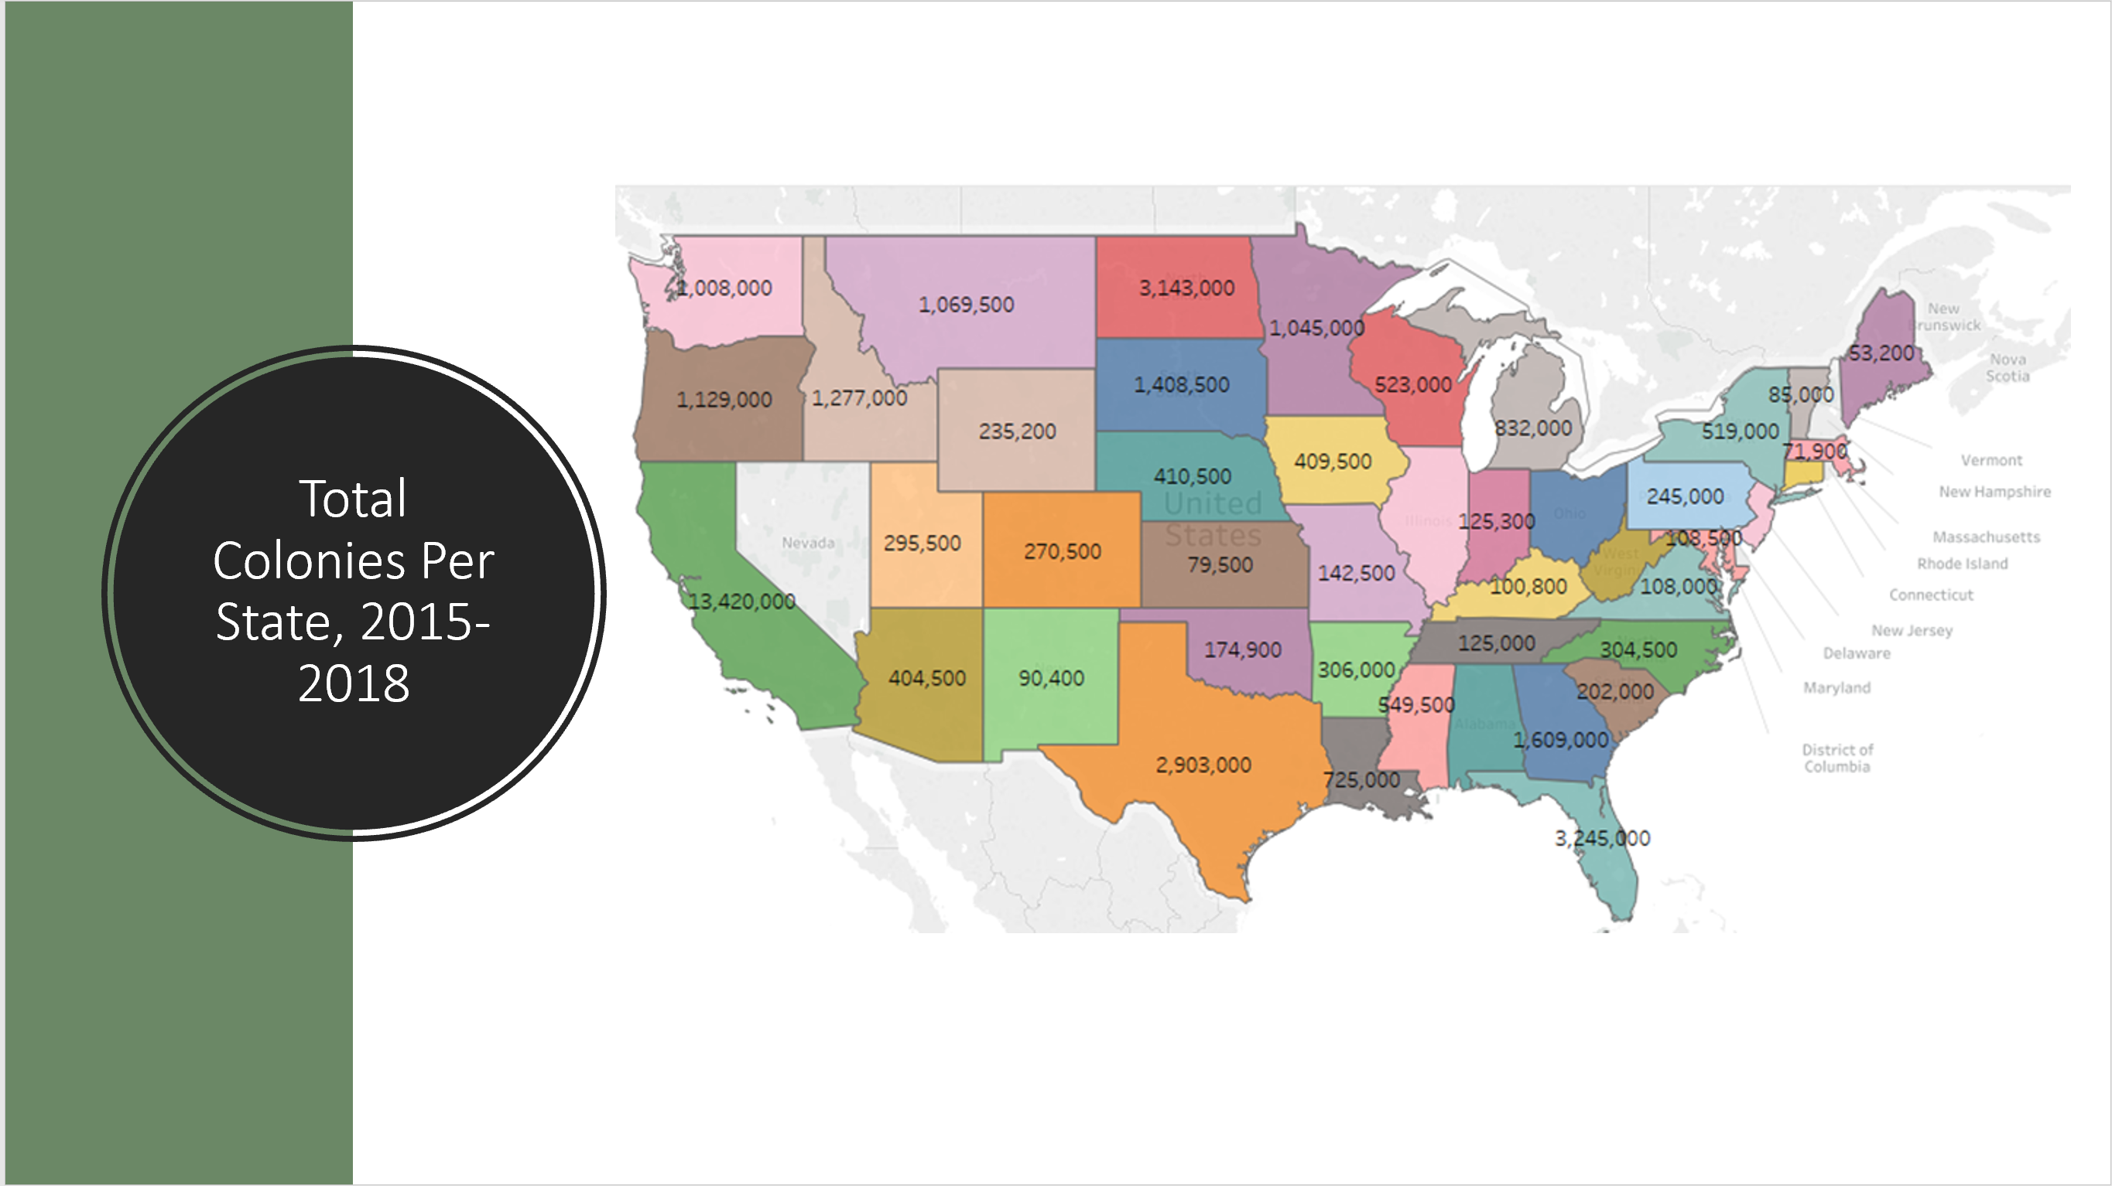

Slide 12
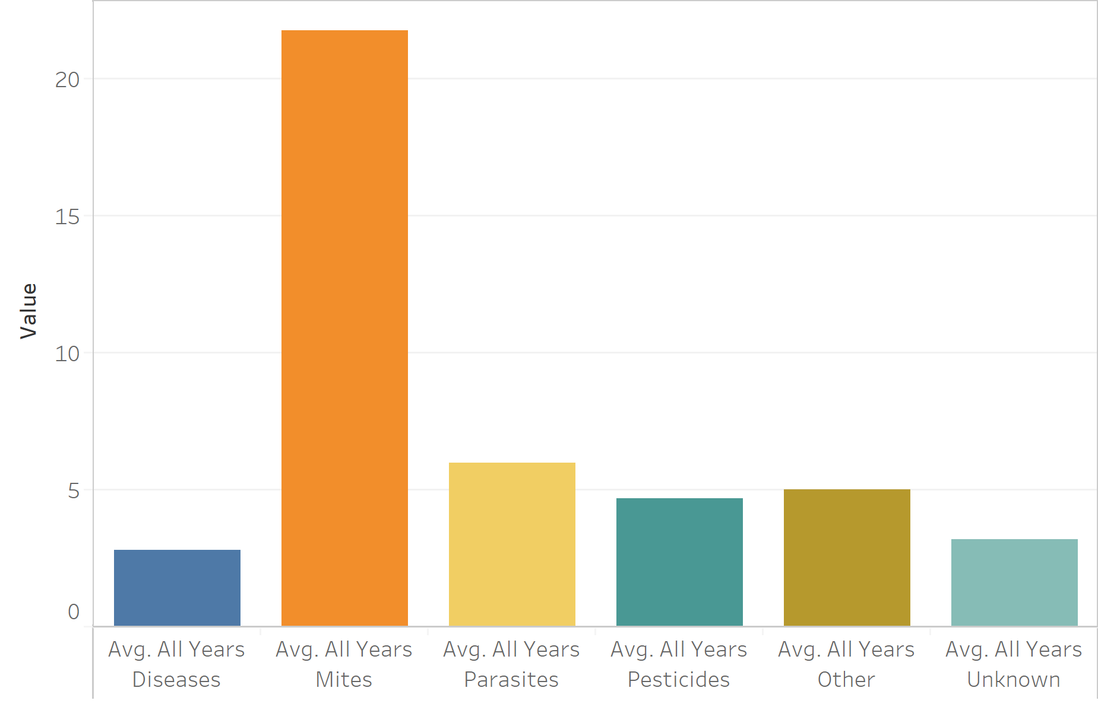
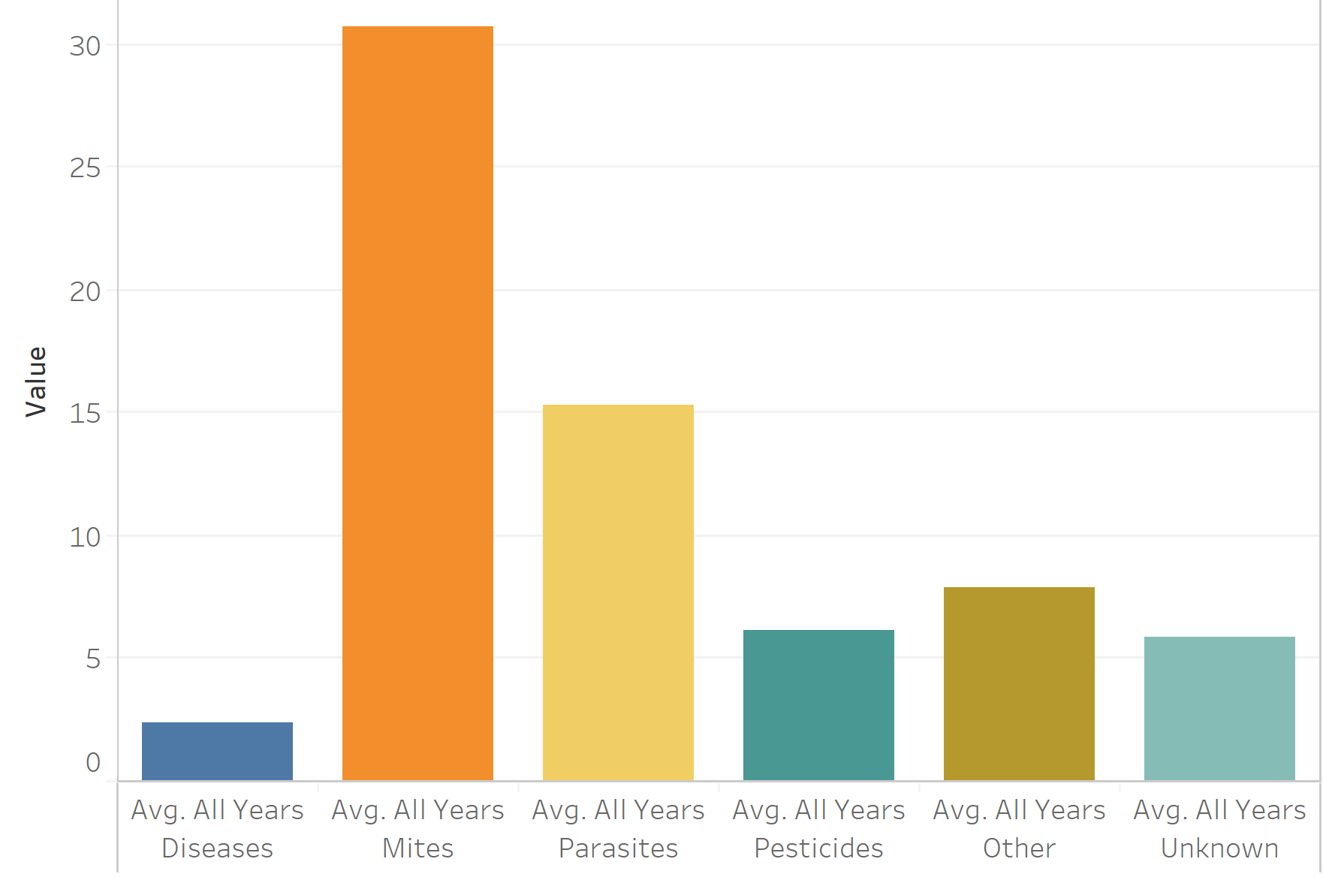
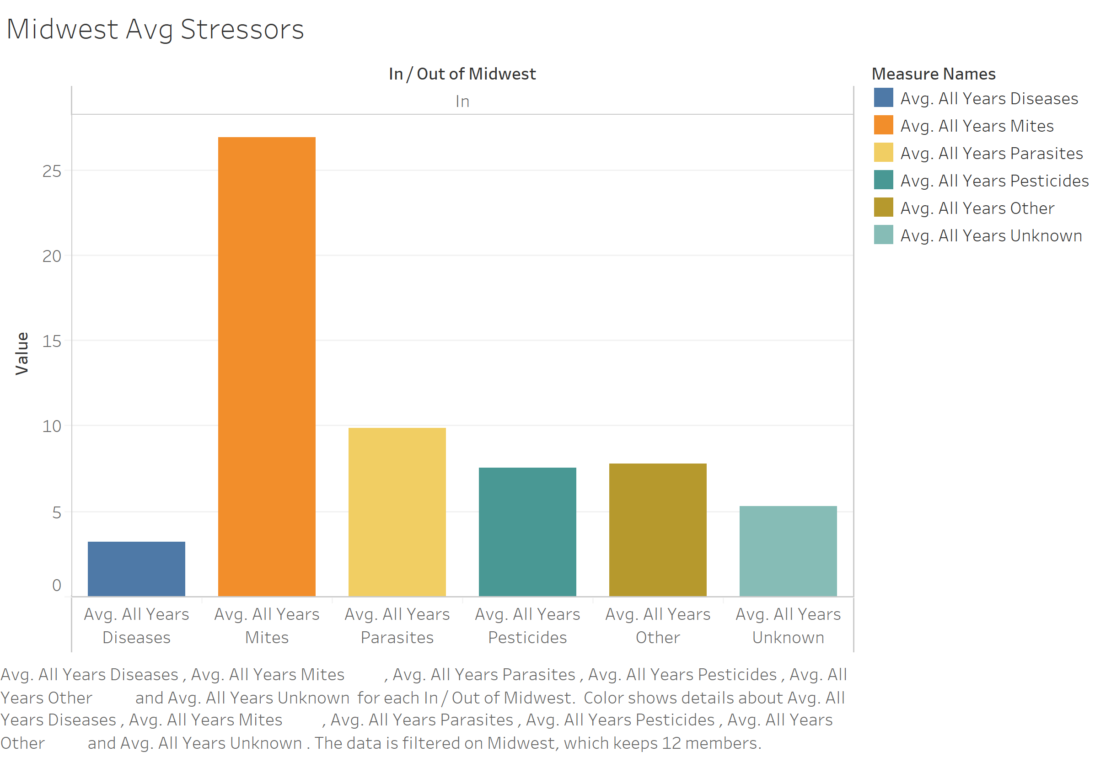
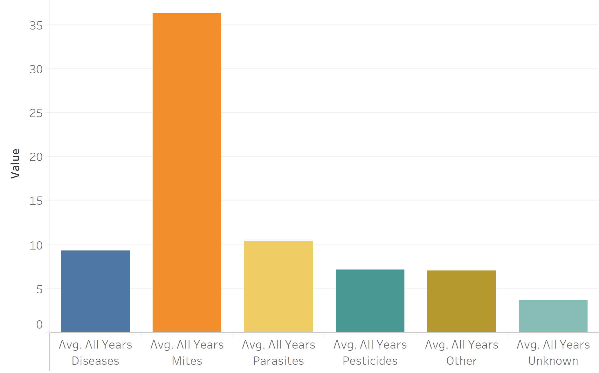
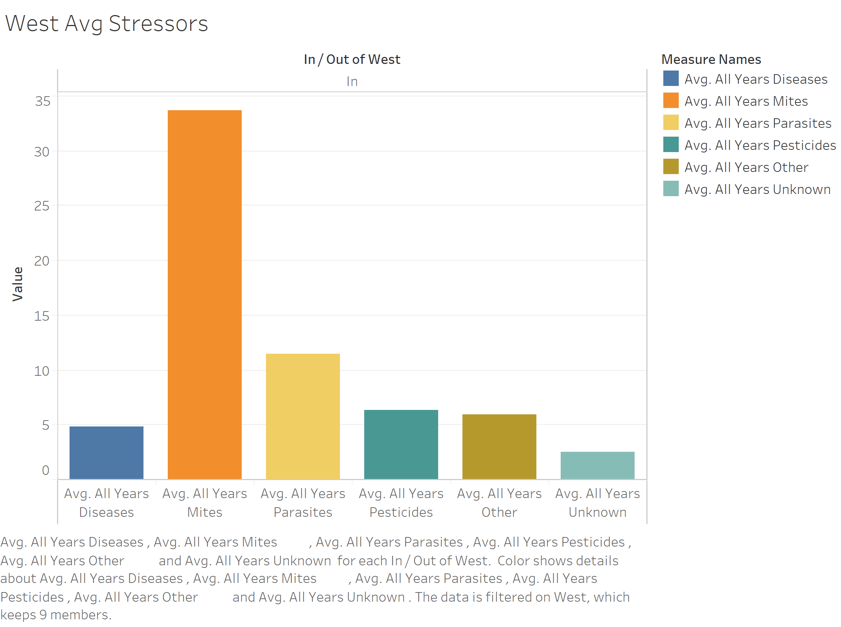
Average Health Stressors by Region 2015-2018
Northeast
Southeast
Midwest
Southwest
West

Slide 13
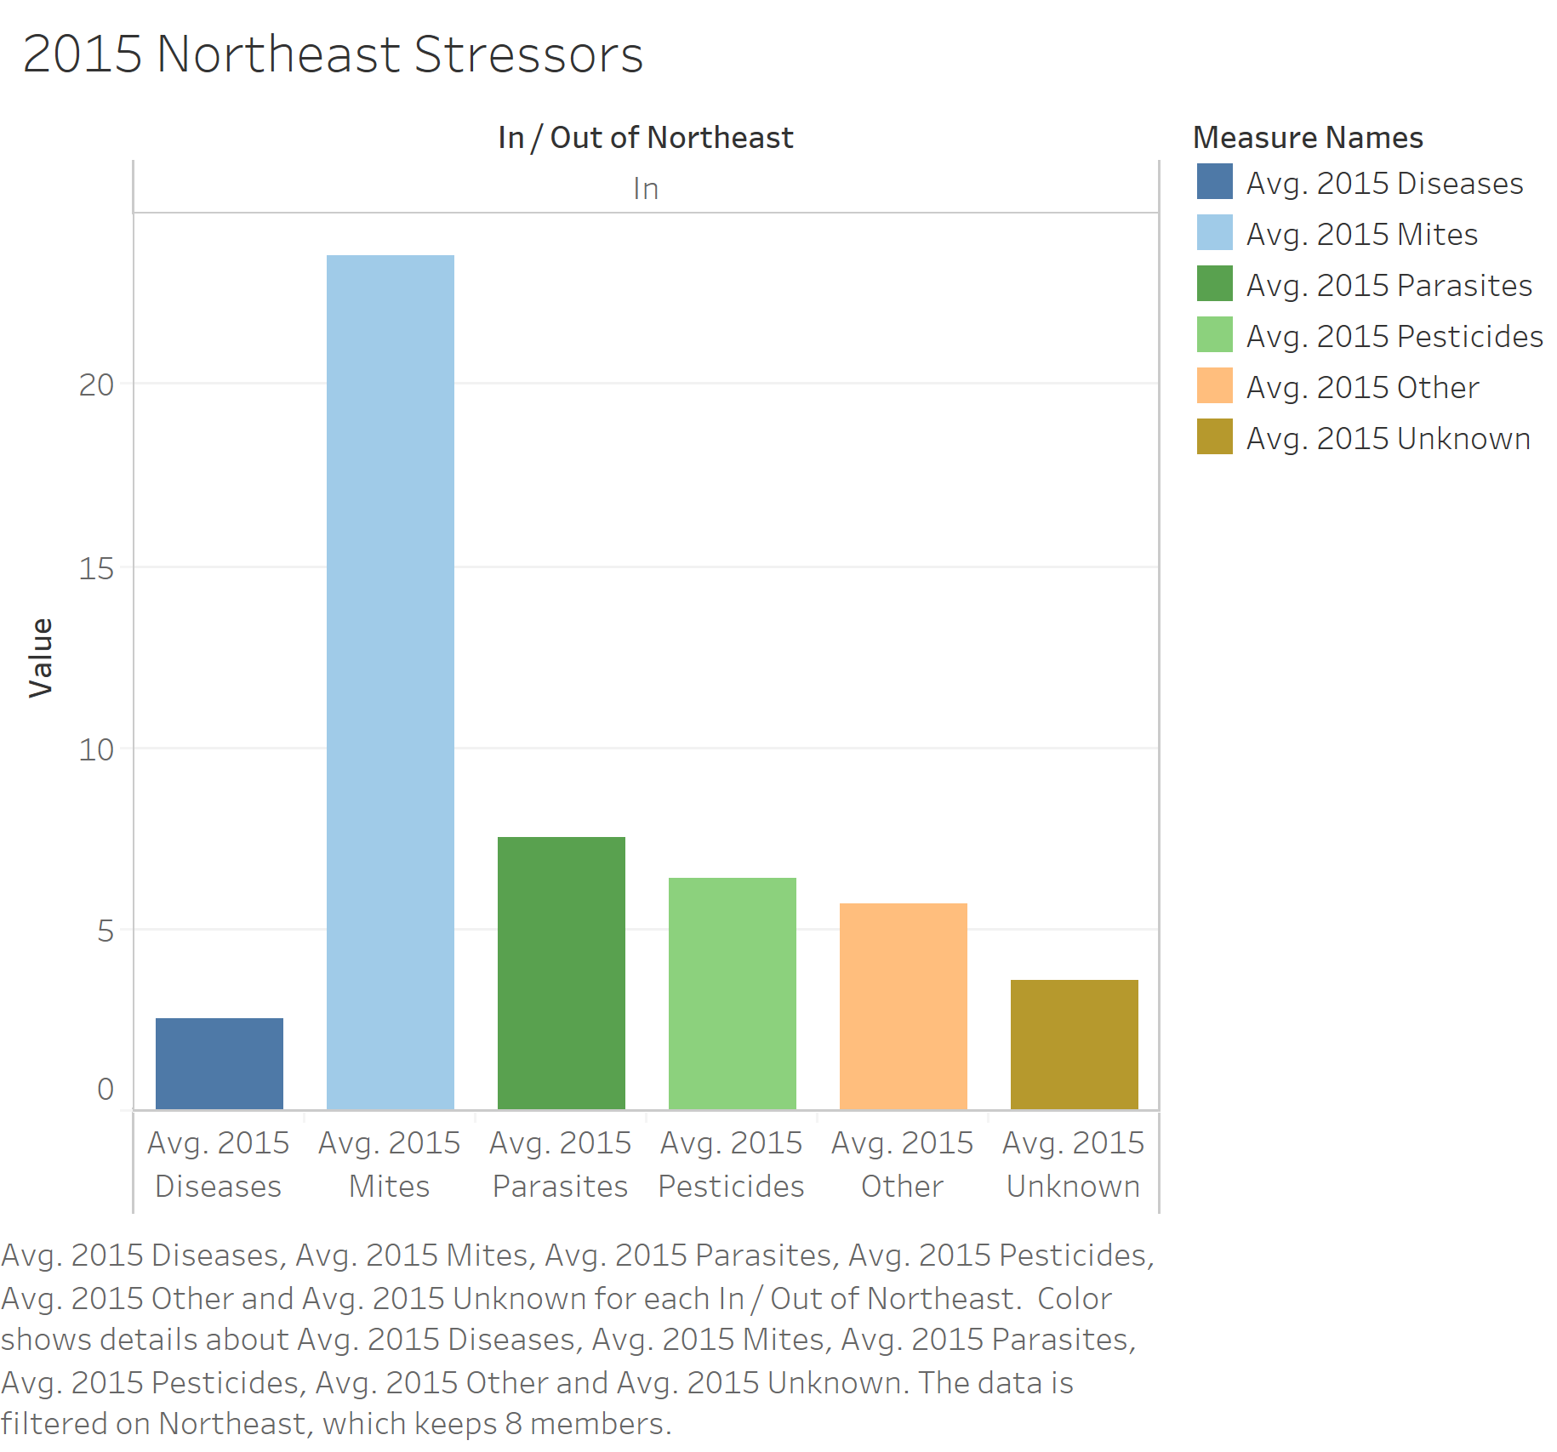
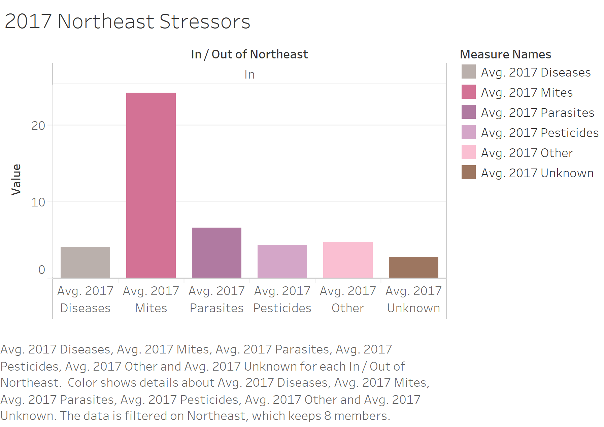
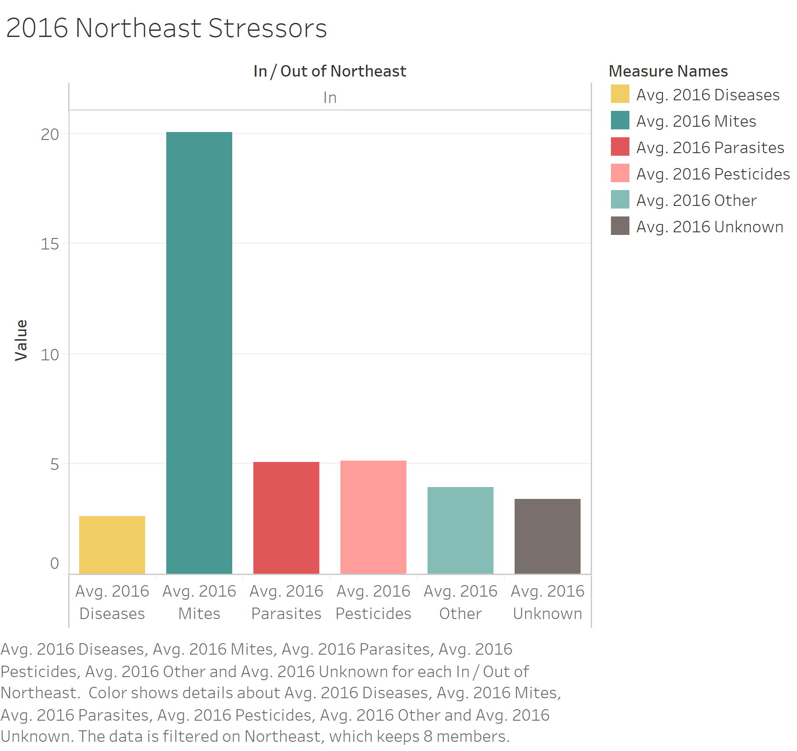
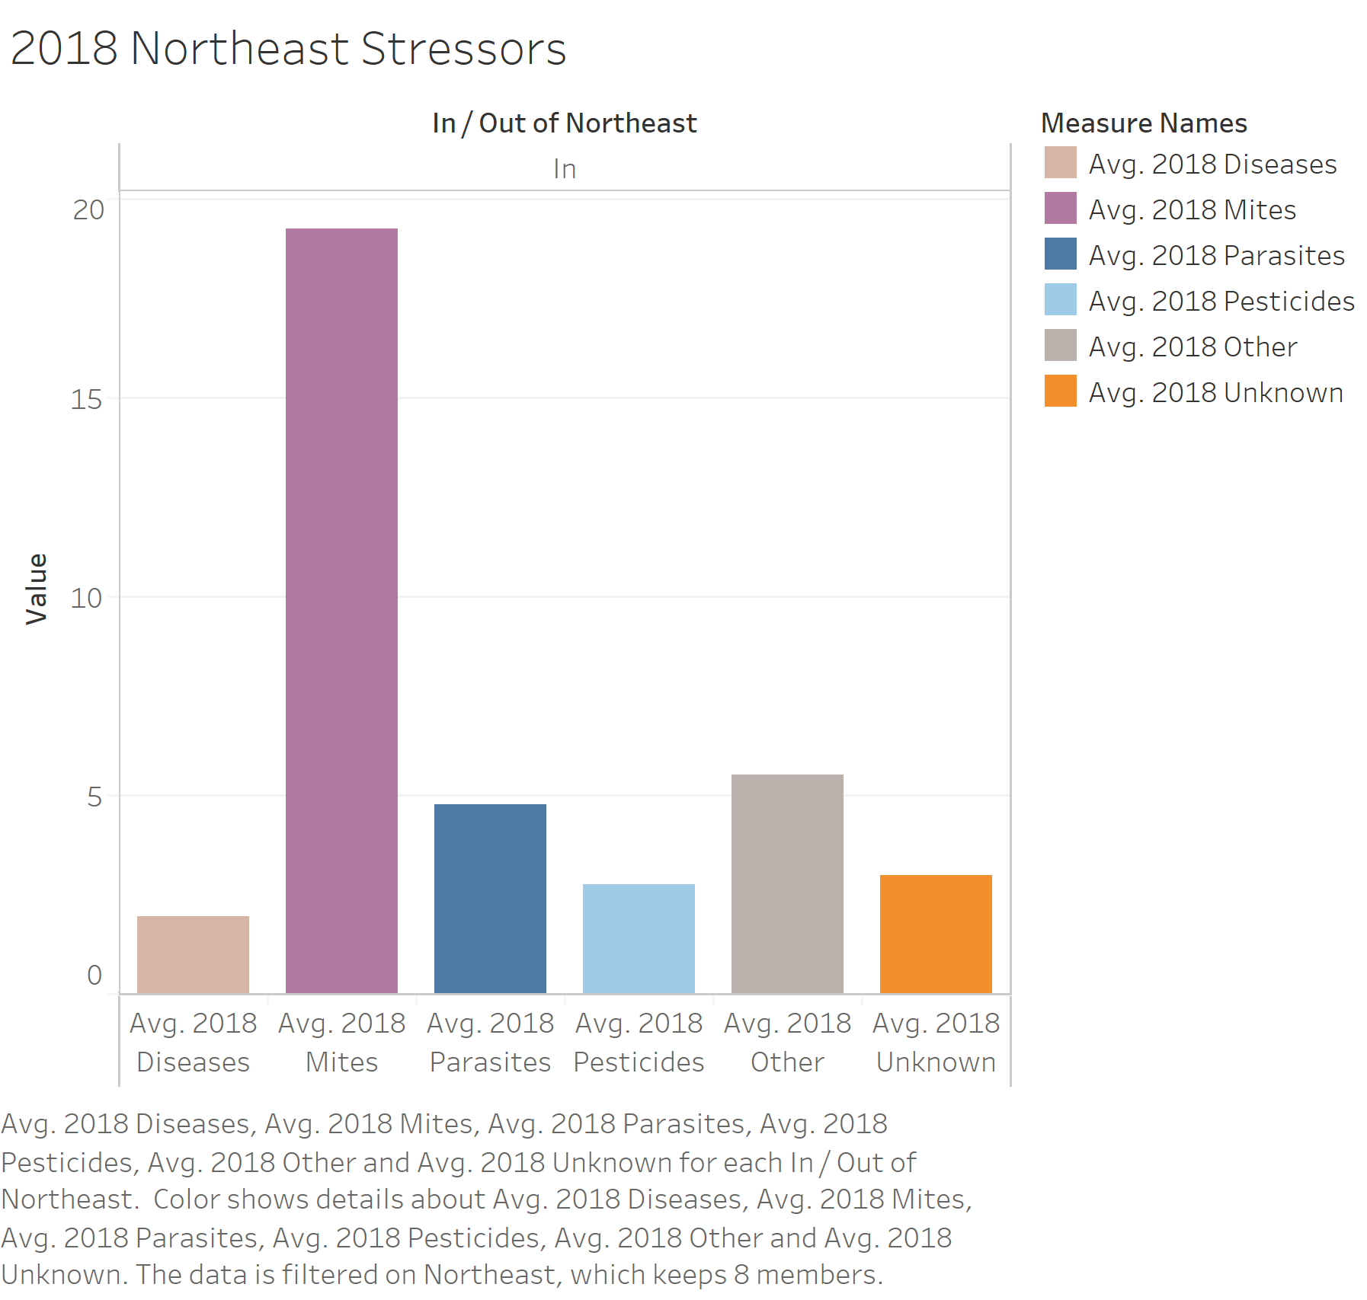
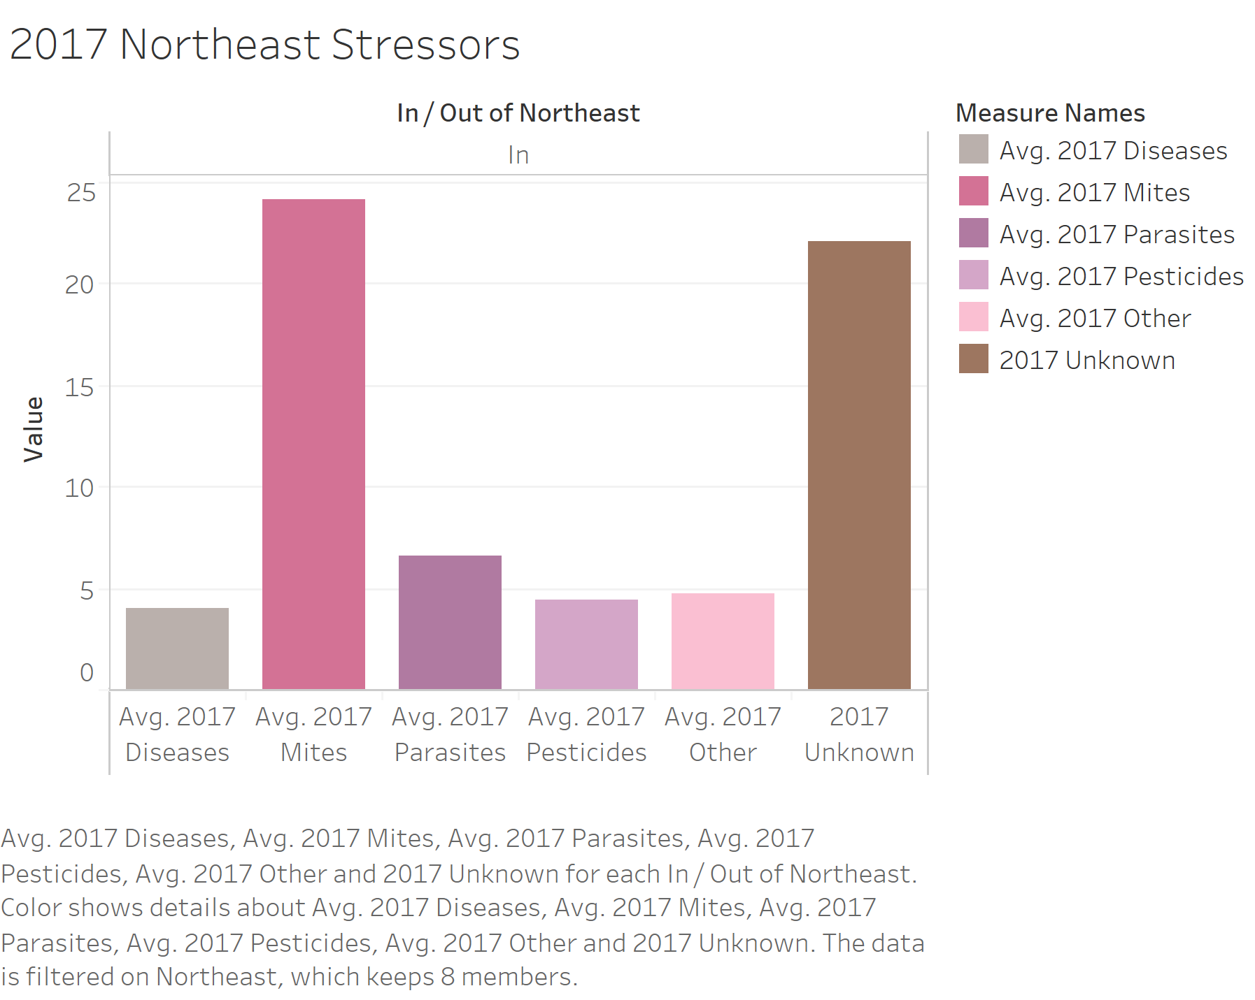
Northeast Health Stressors 2015-2018
2015
2016
2017
2018

Slide 14
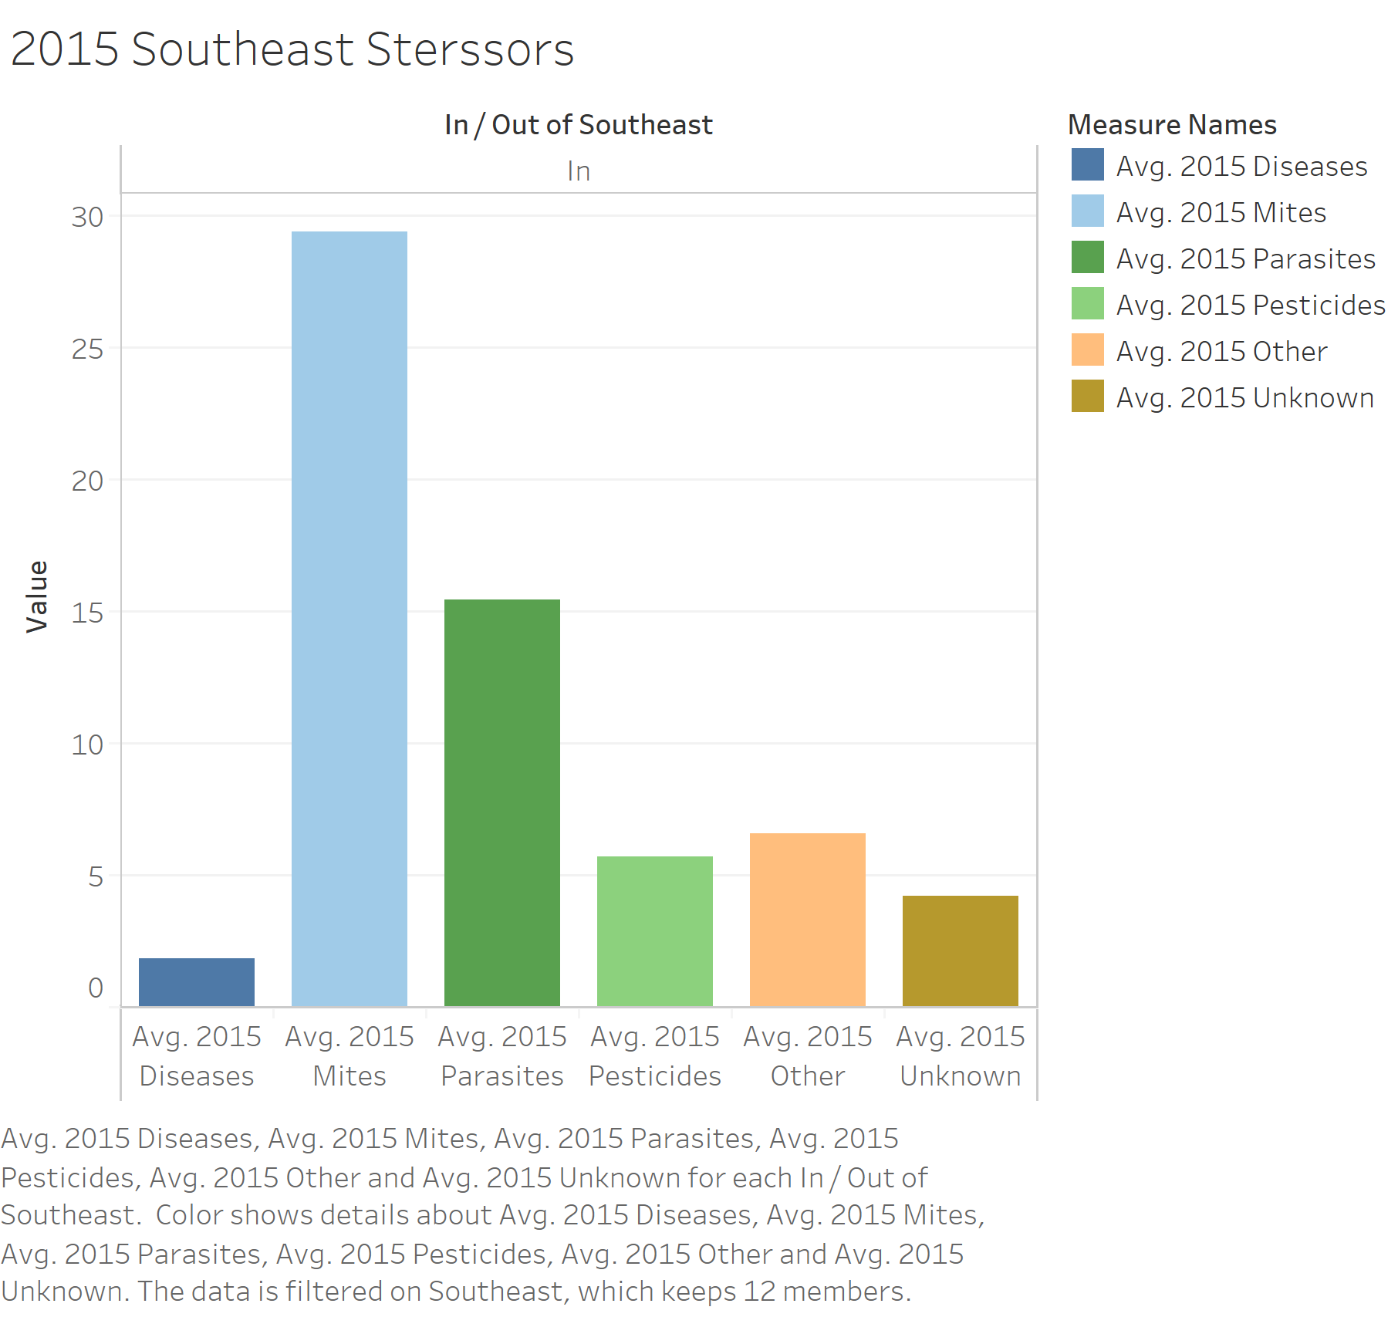
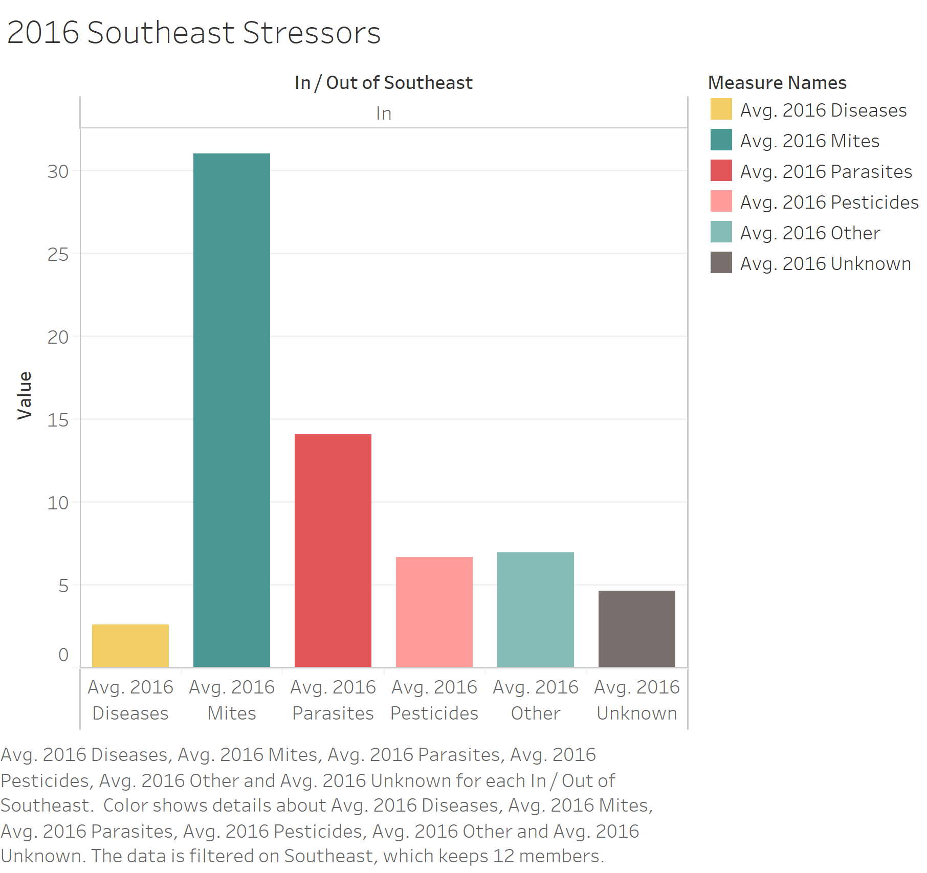
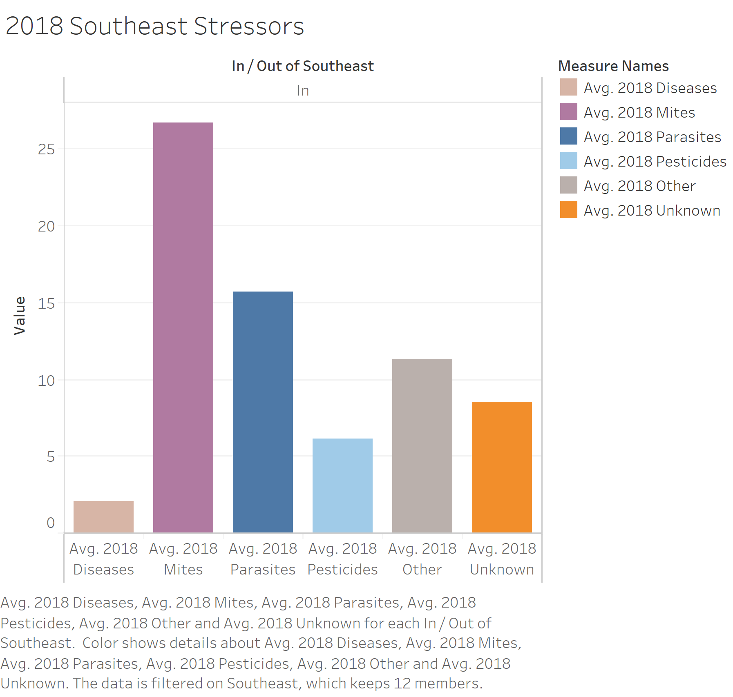
Southeast Health Stressors 2015-2018
2015
2016
2017
2018

Slide 15
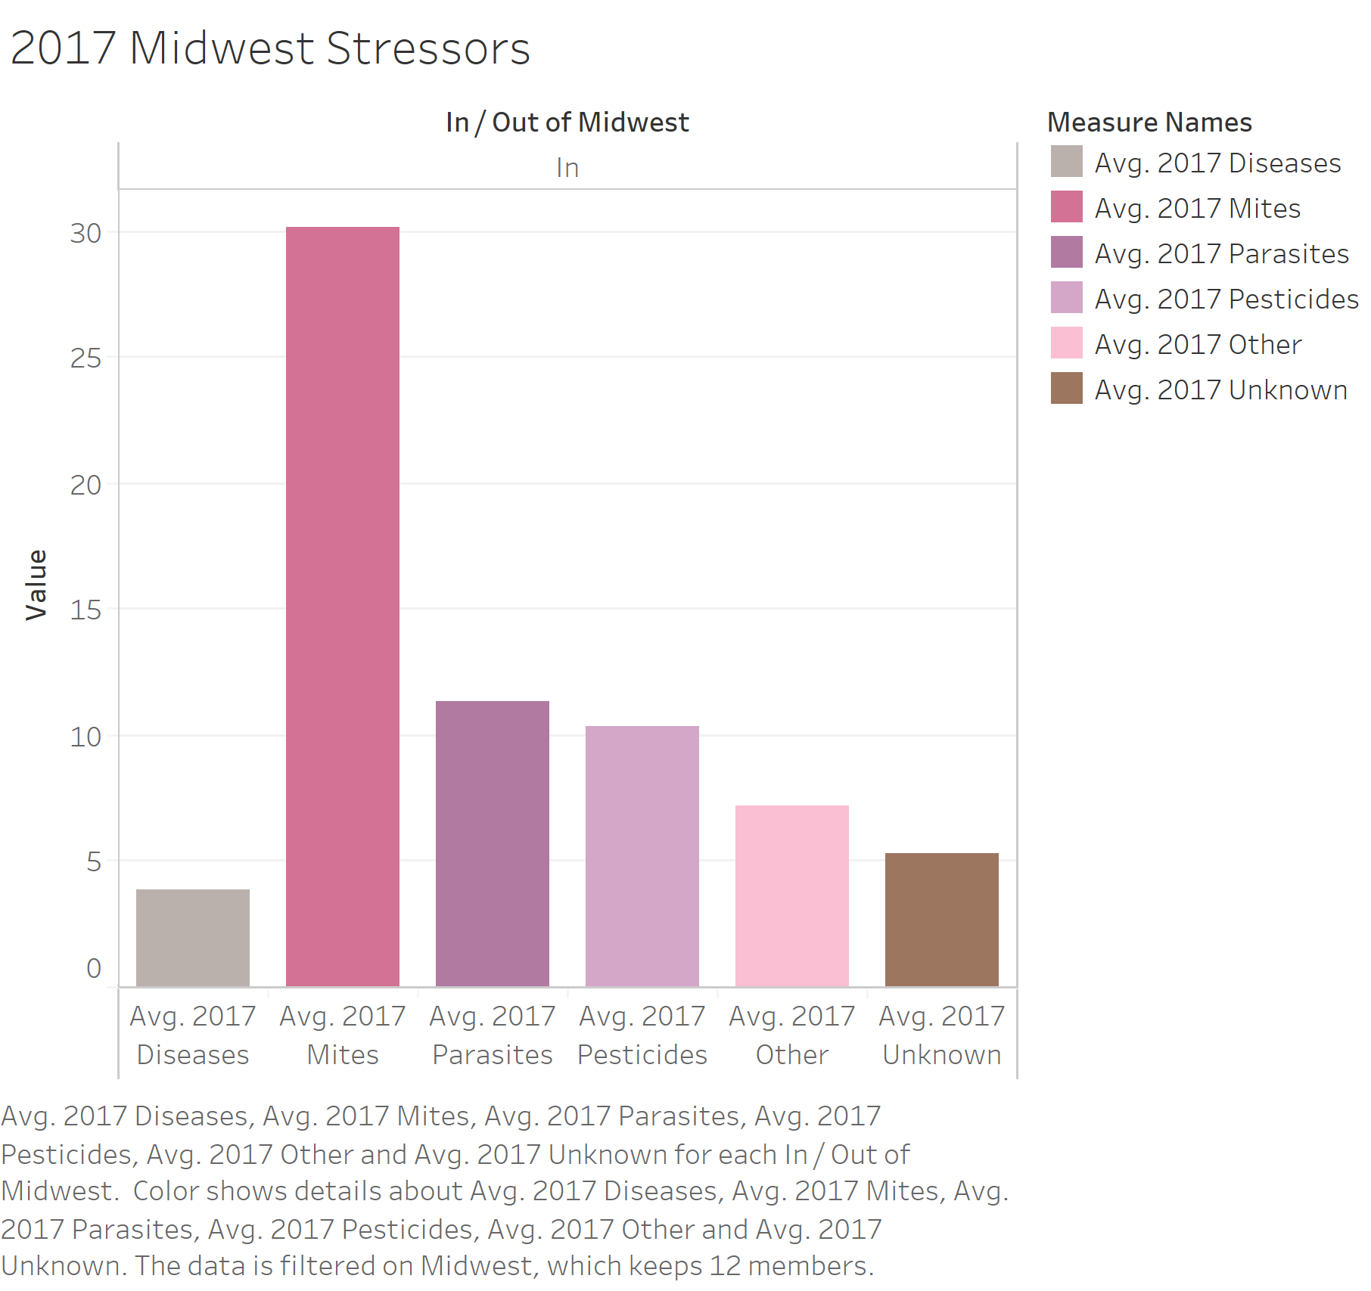
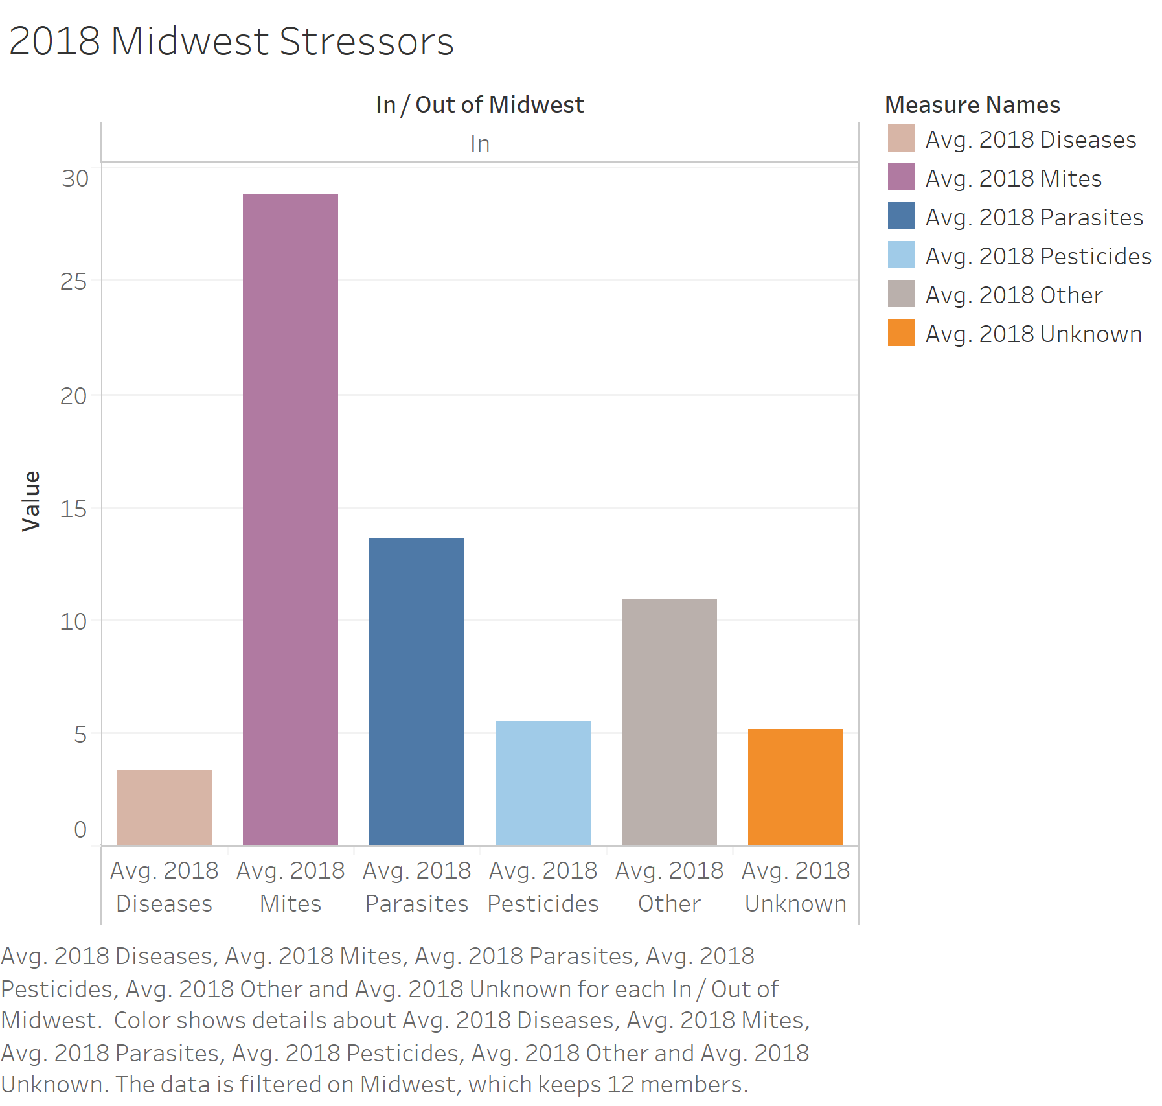
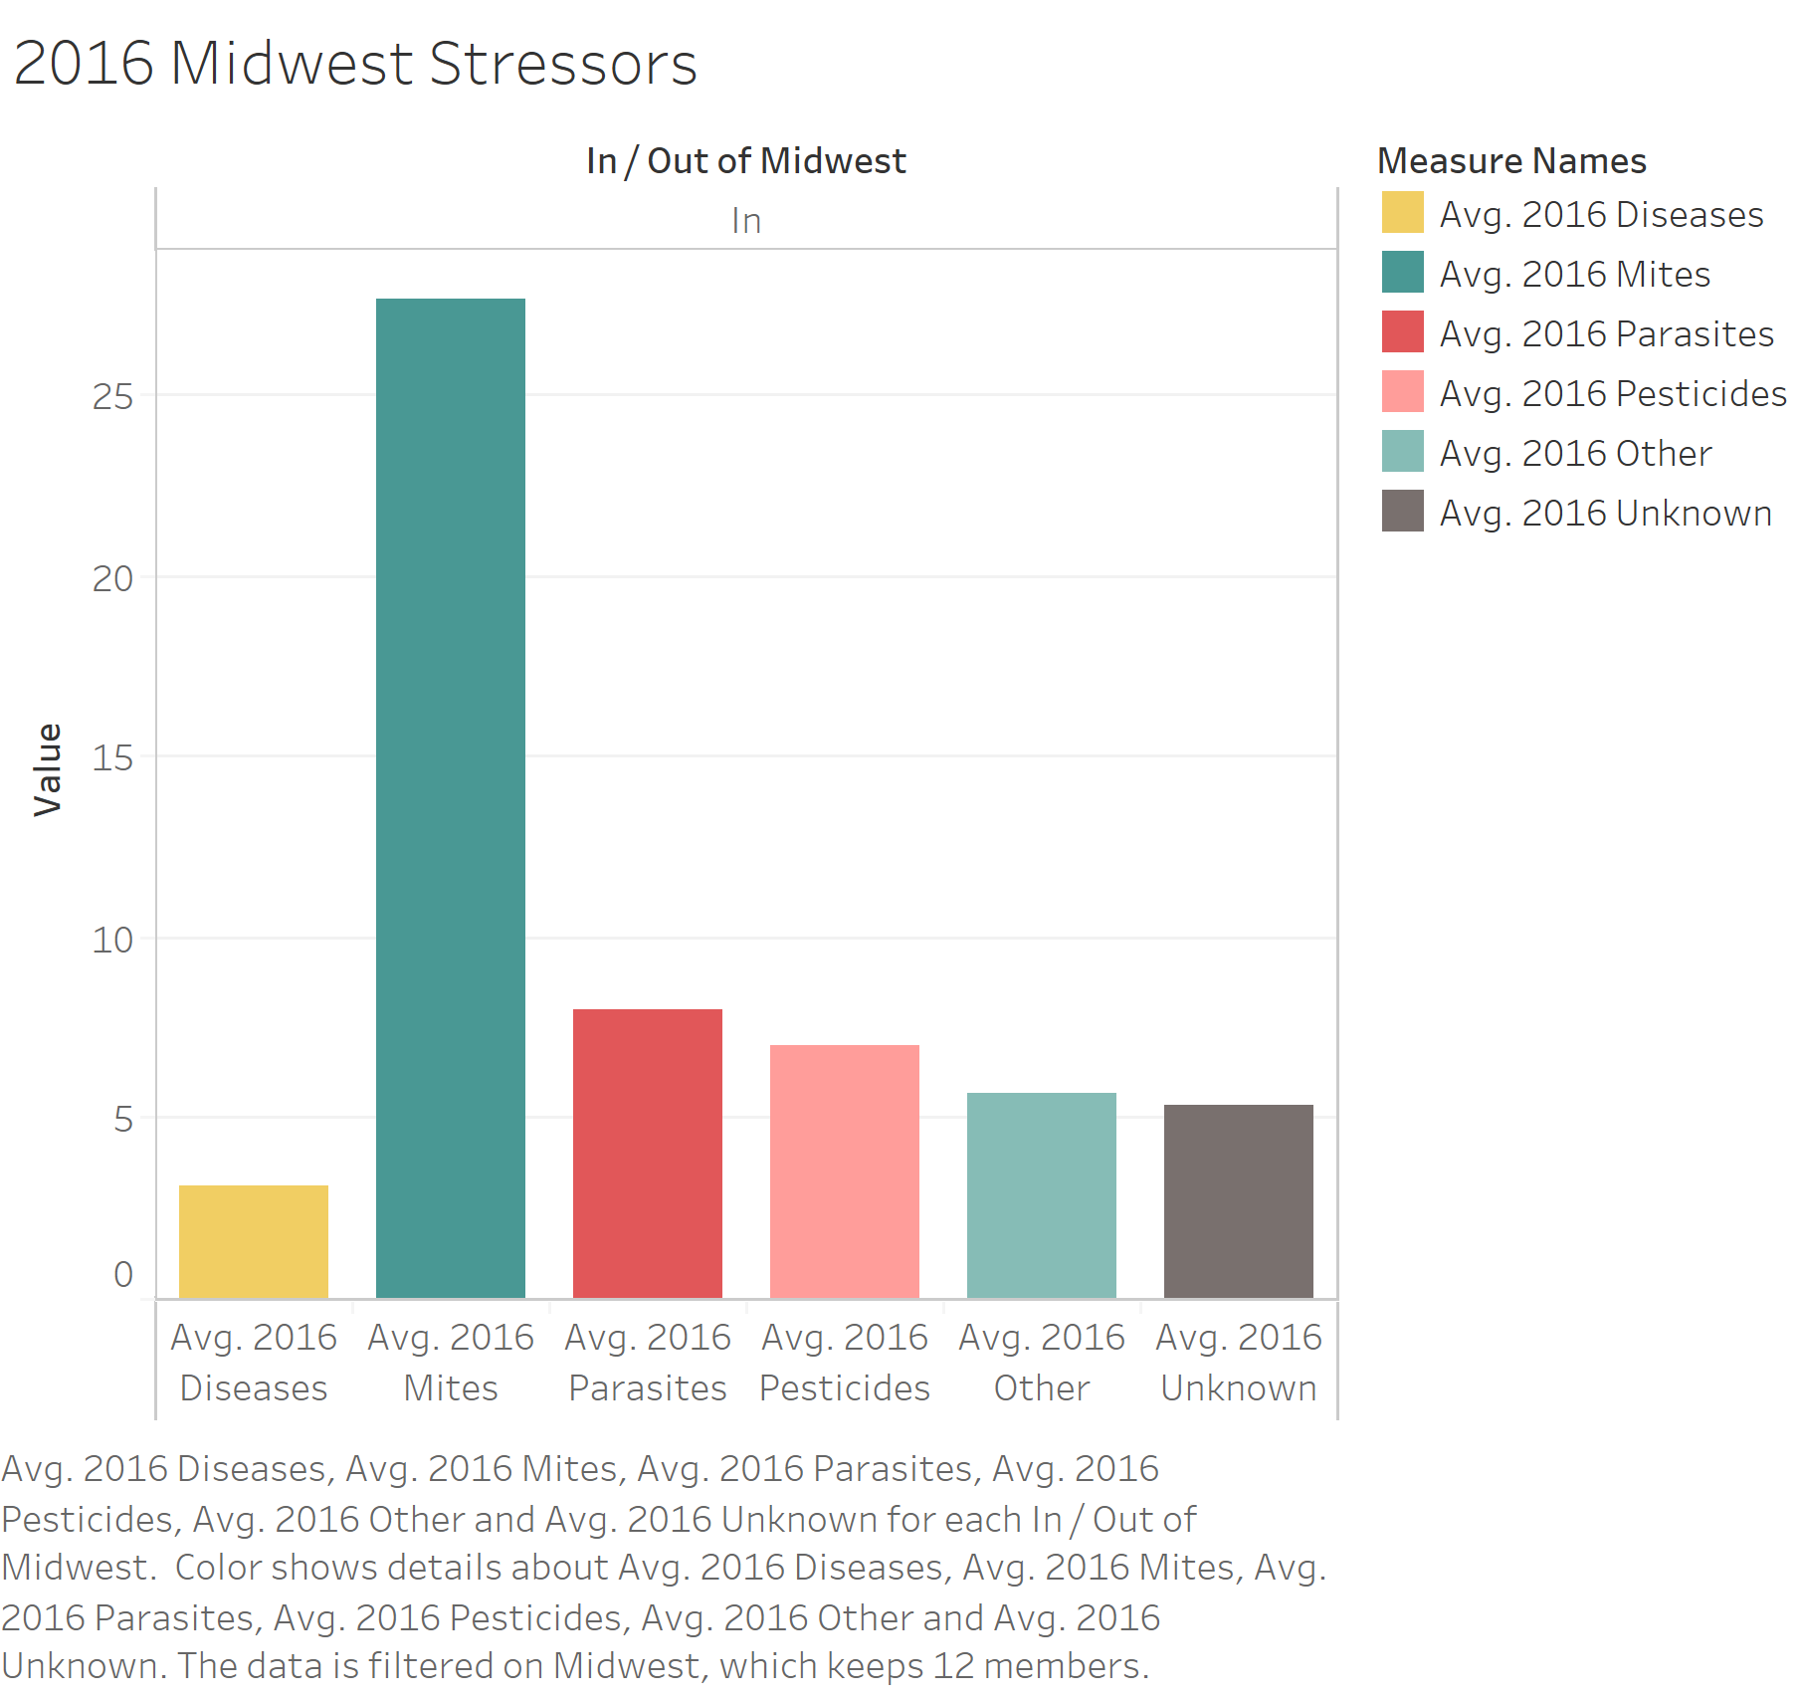
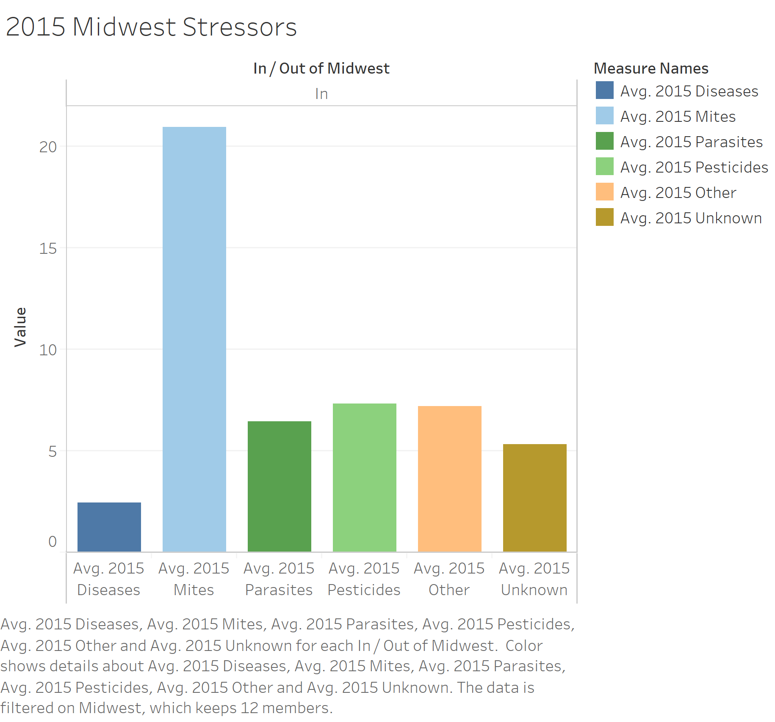
Midwest Health Stressors 2015-2018
2015
2016
2017
2018

Slide 16
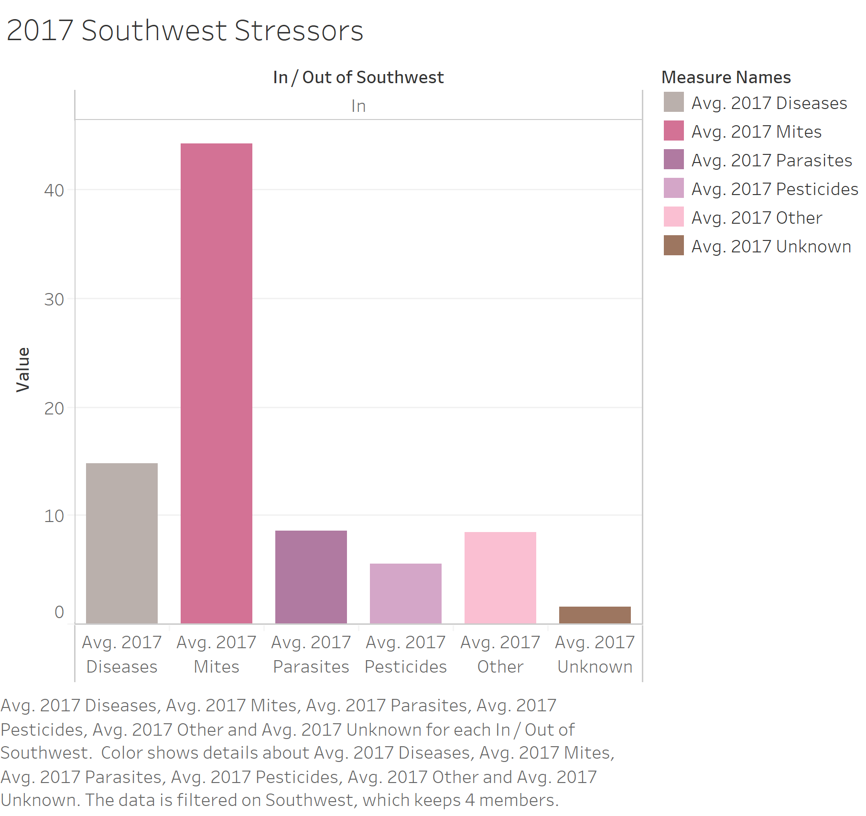
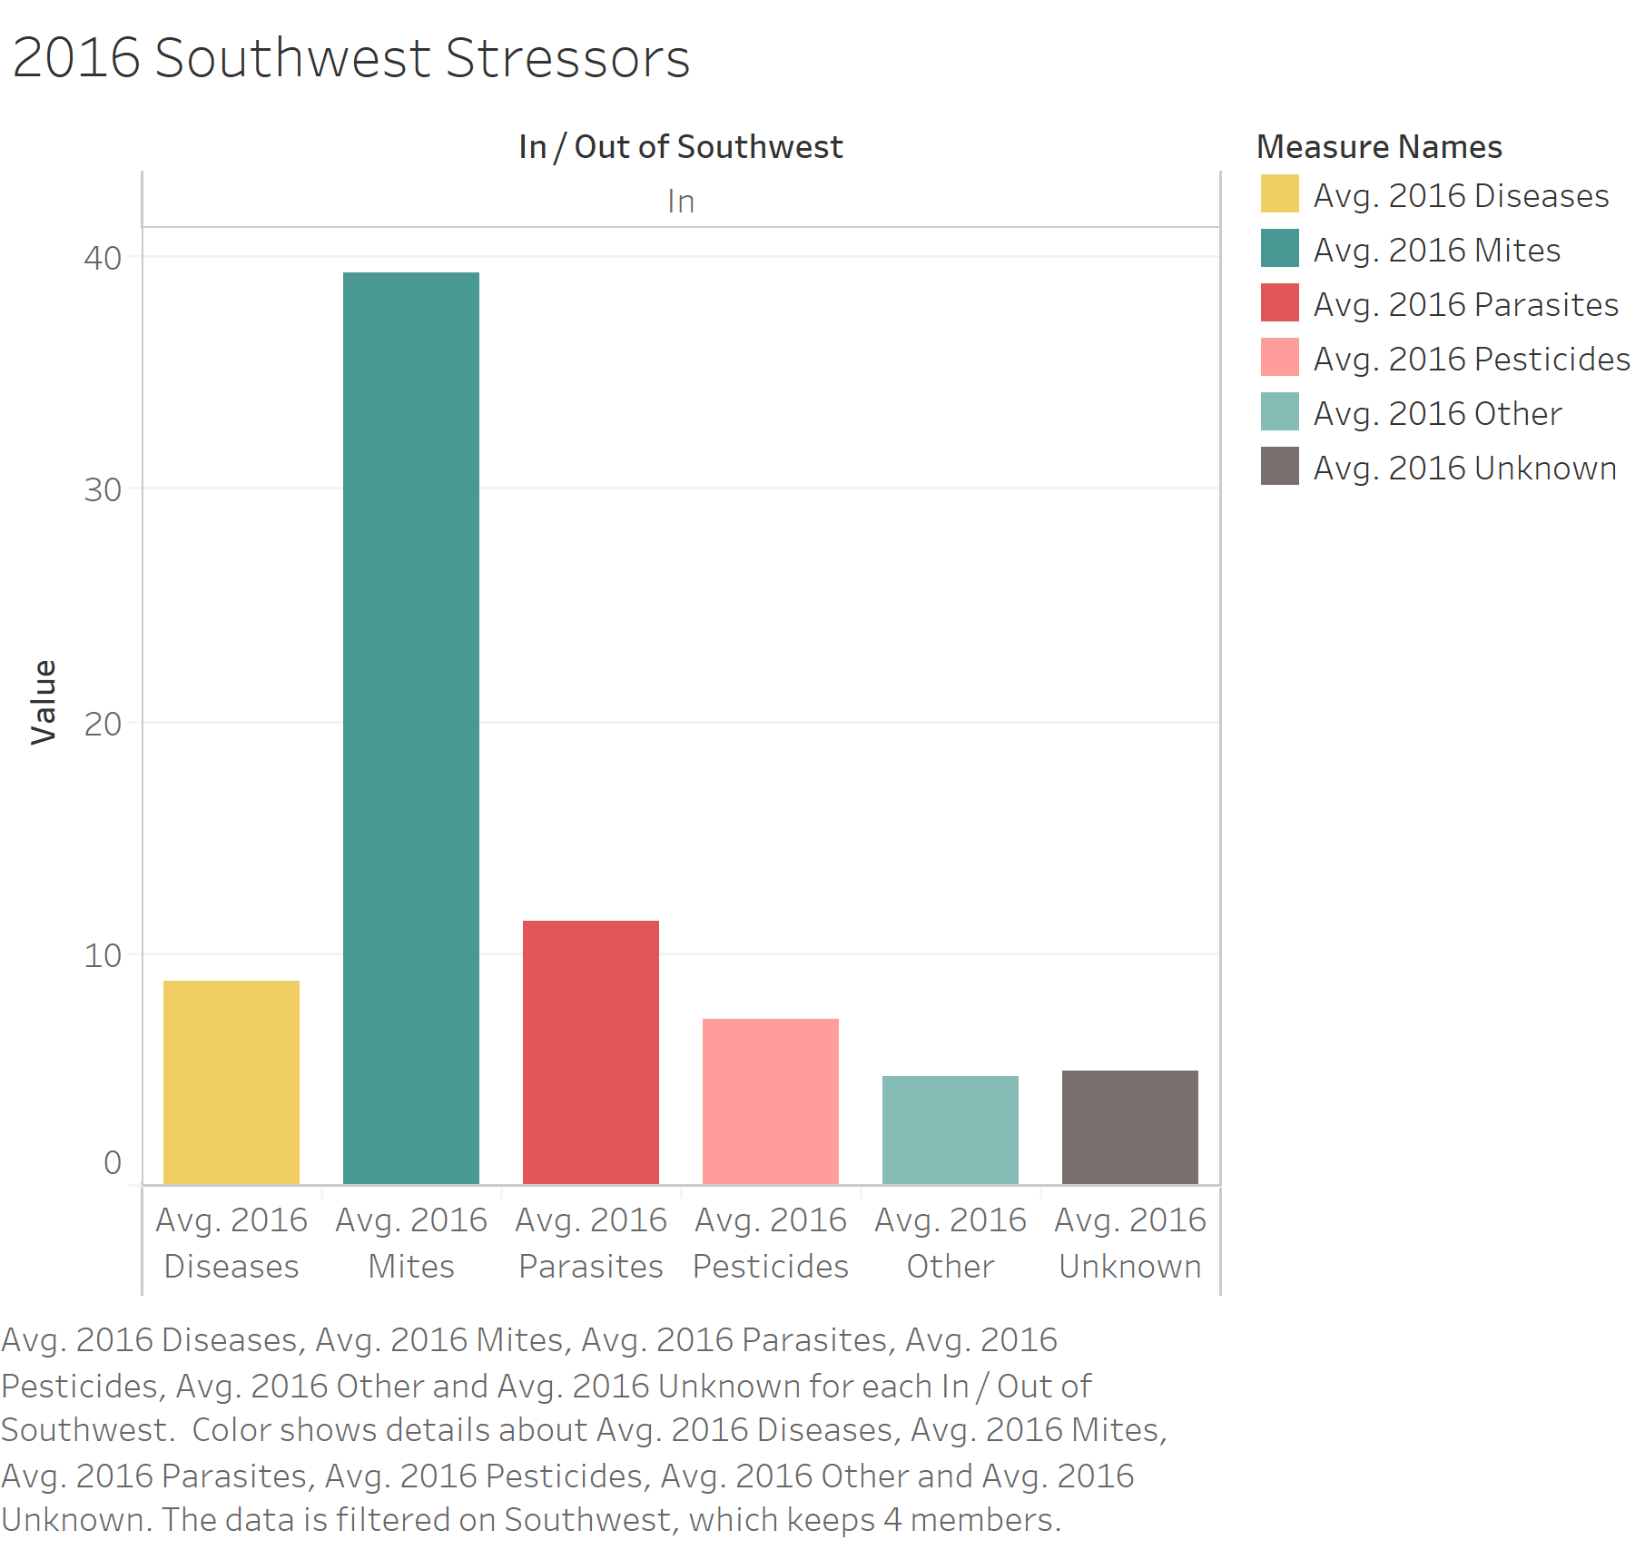
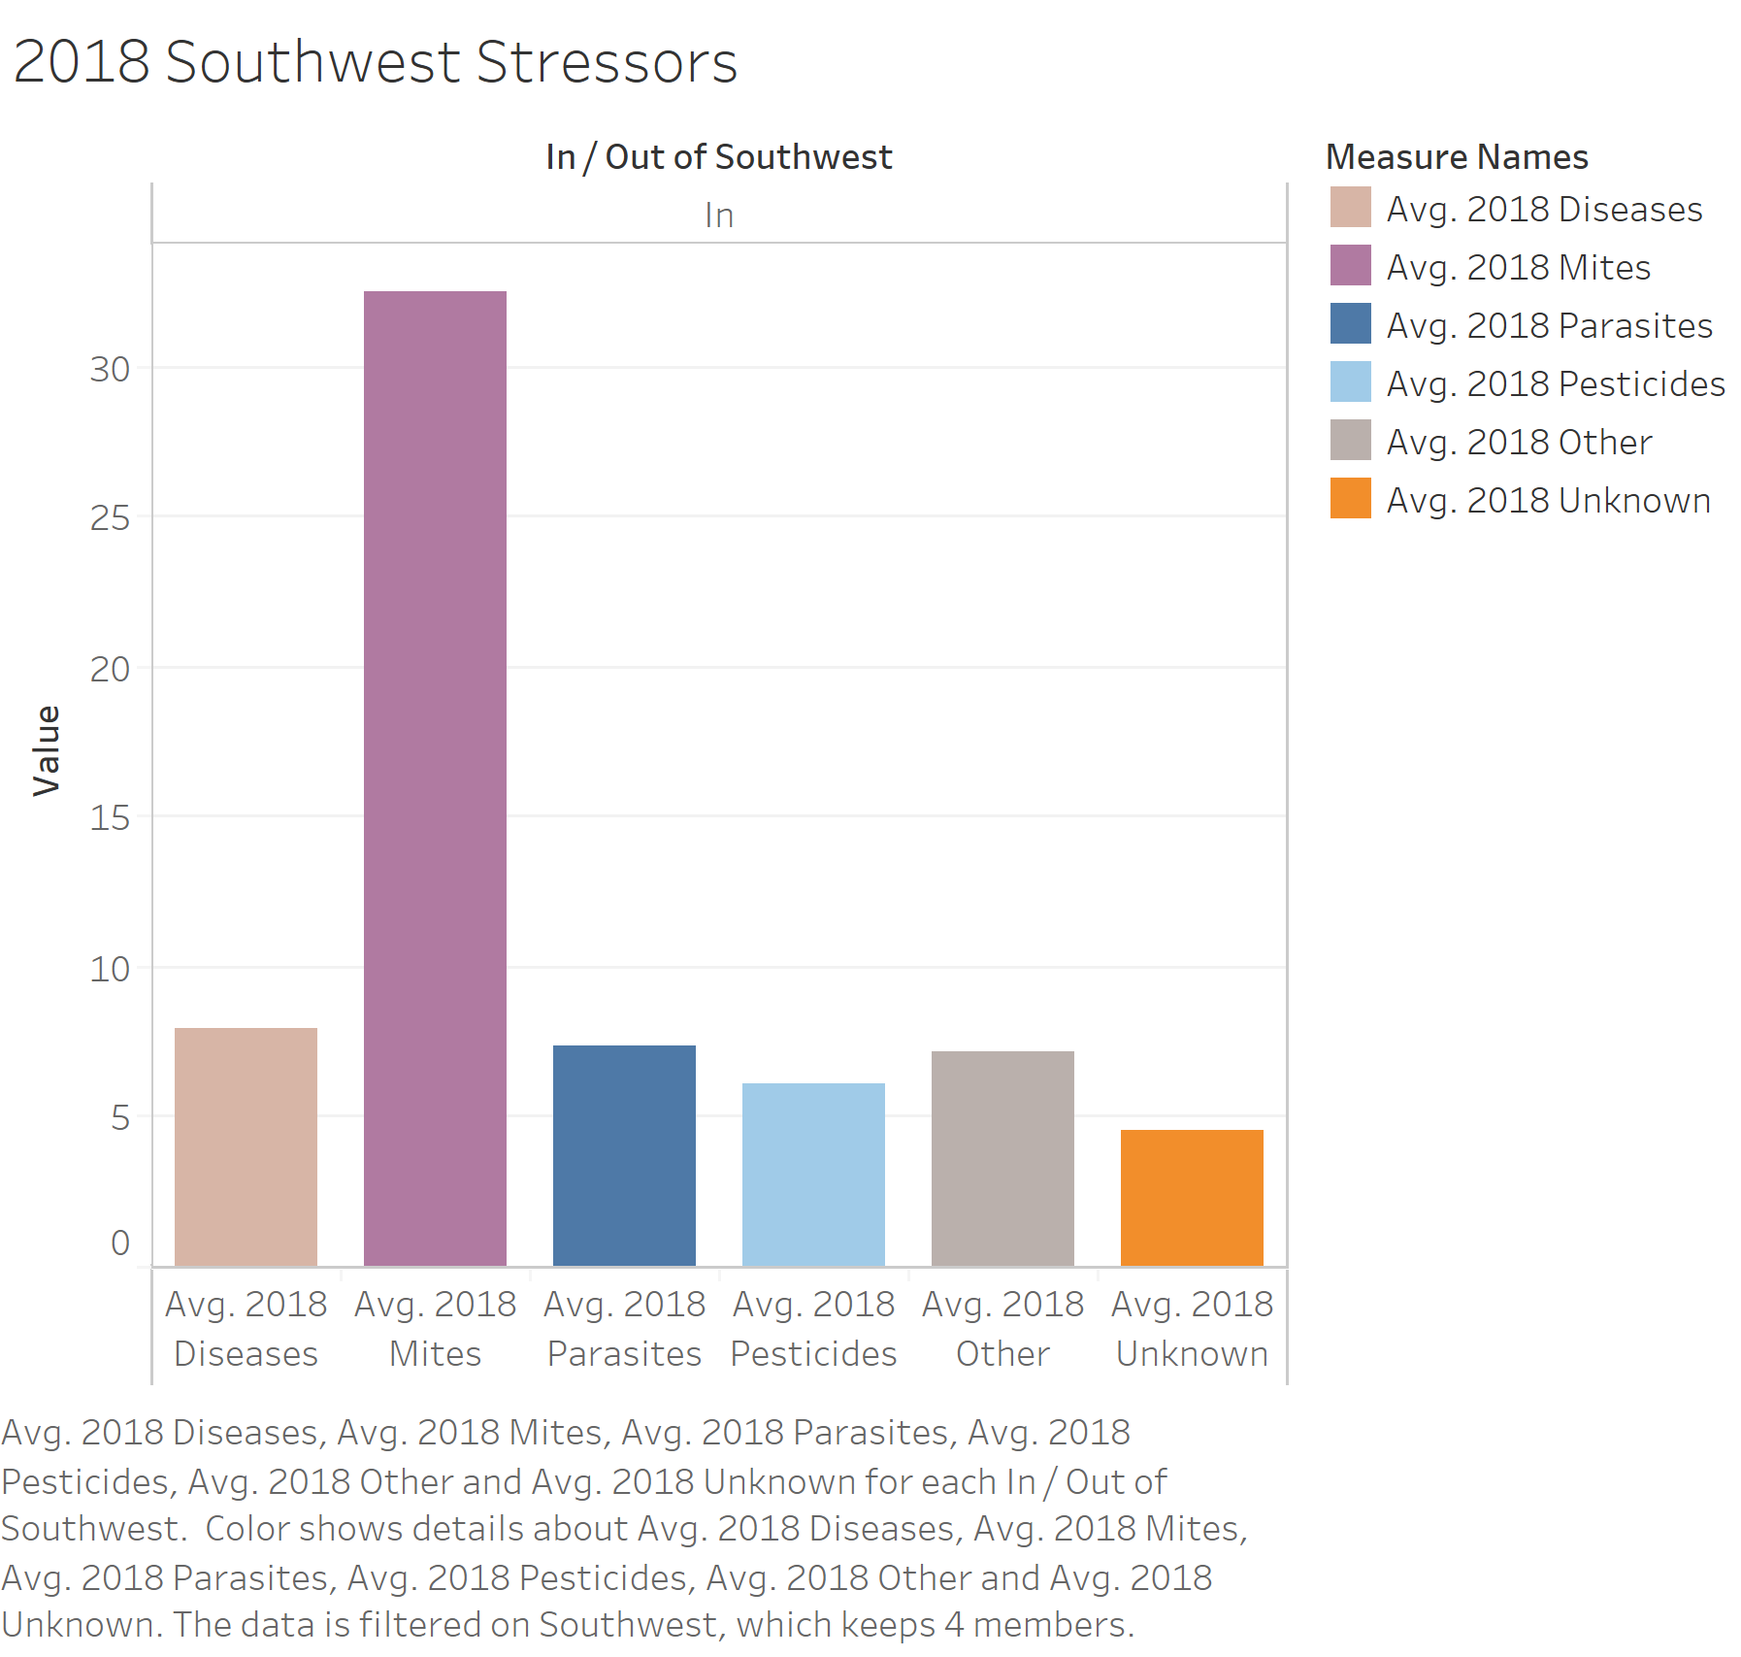
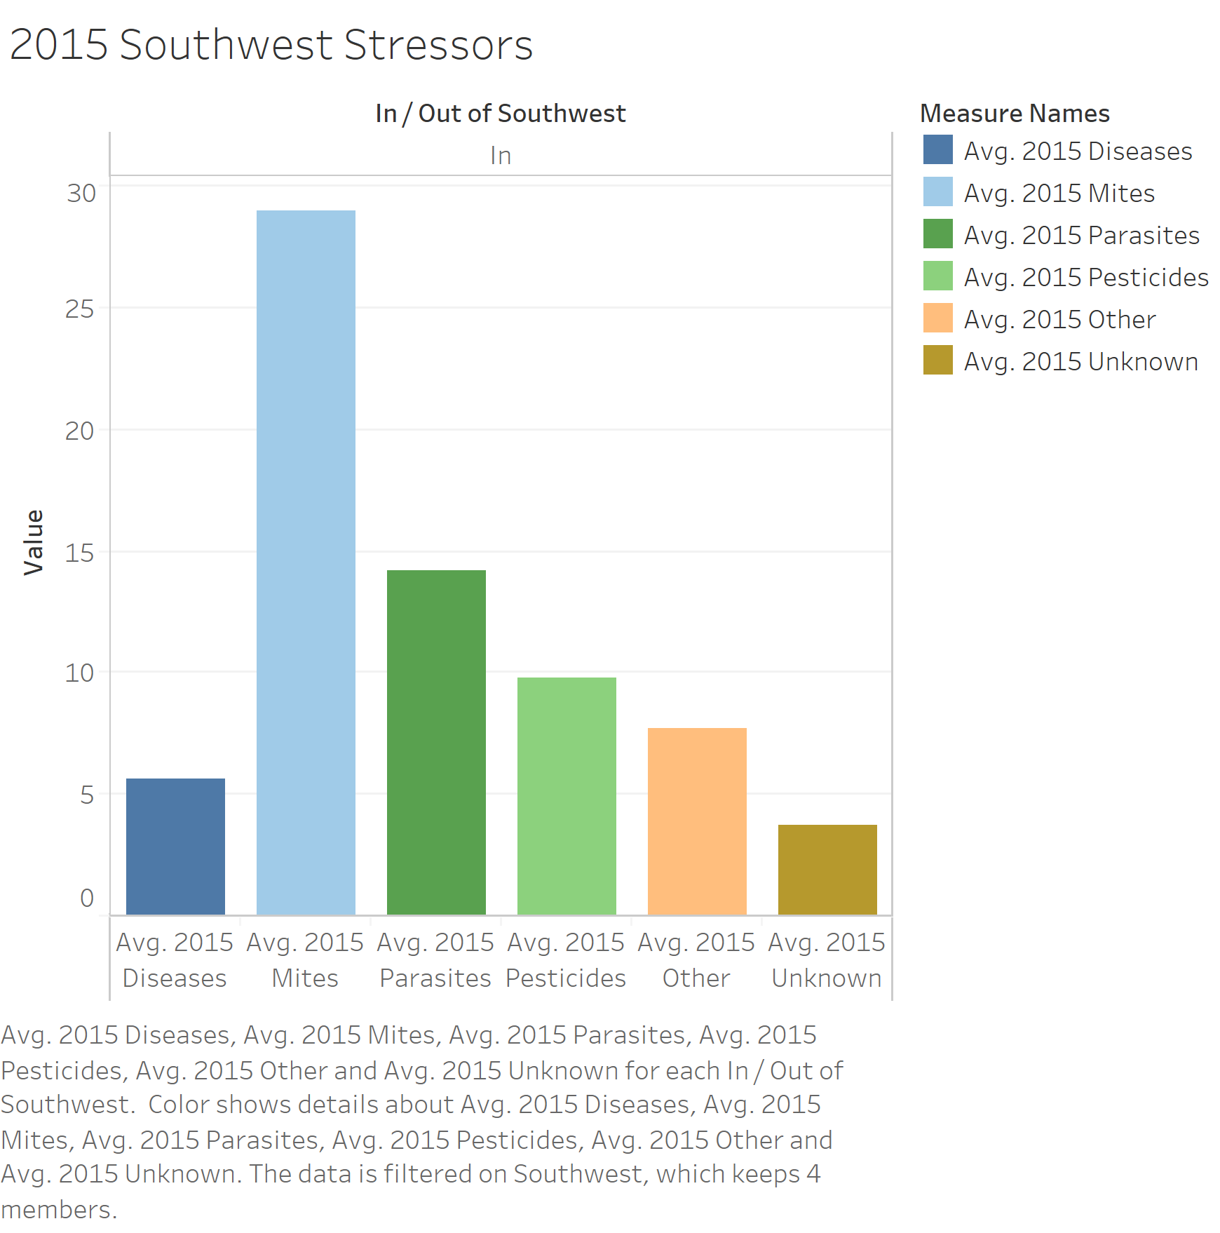
Southwest Health Stressors 2015-2018
2015
2016
2017
2018

Slide 17
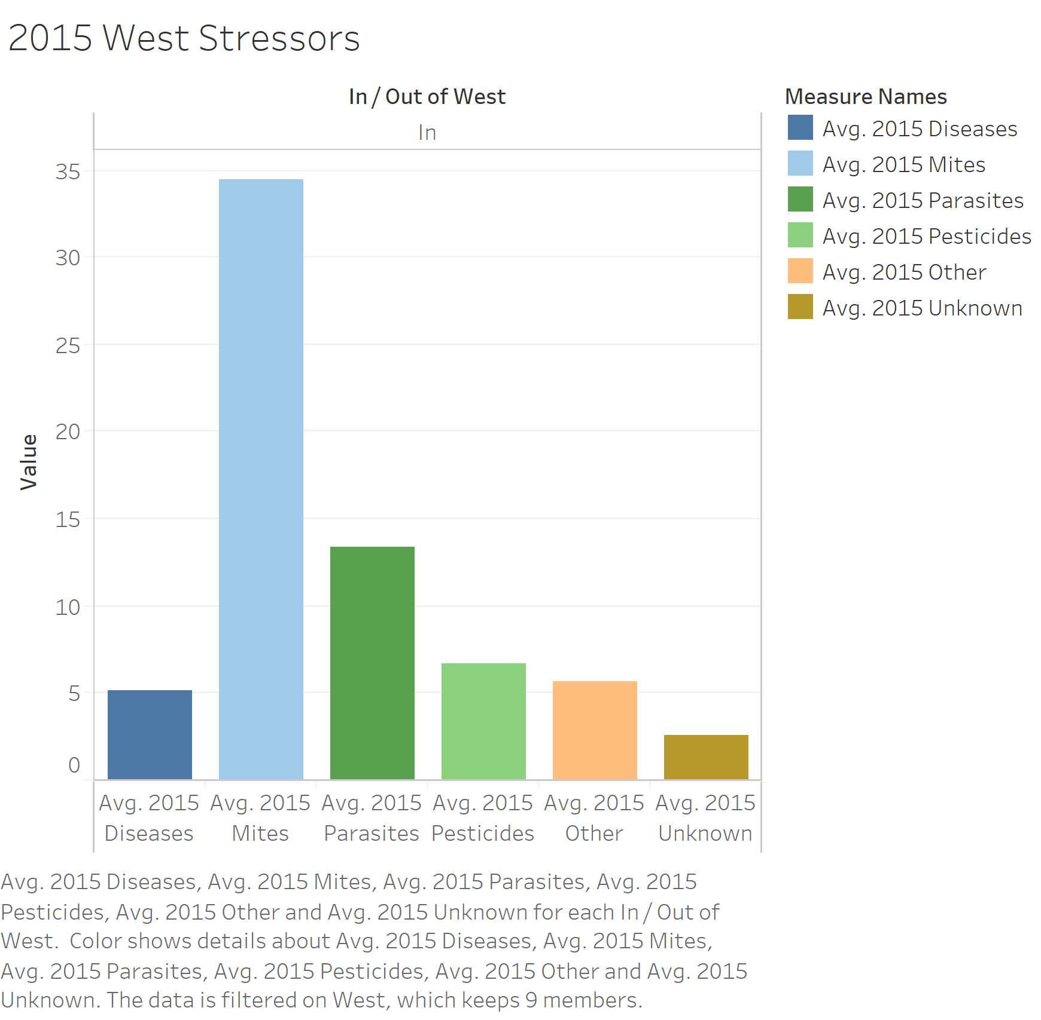
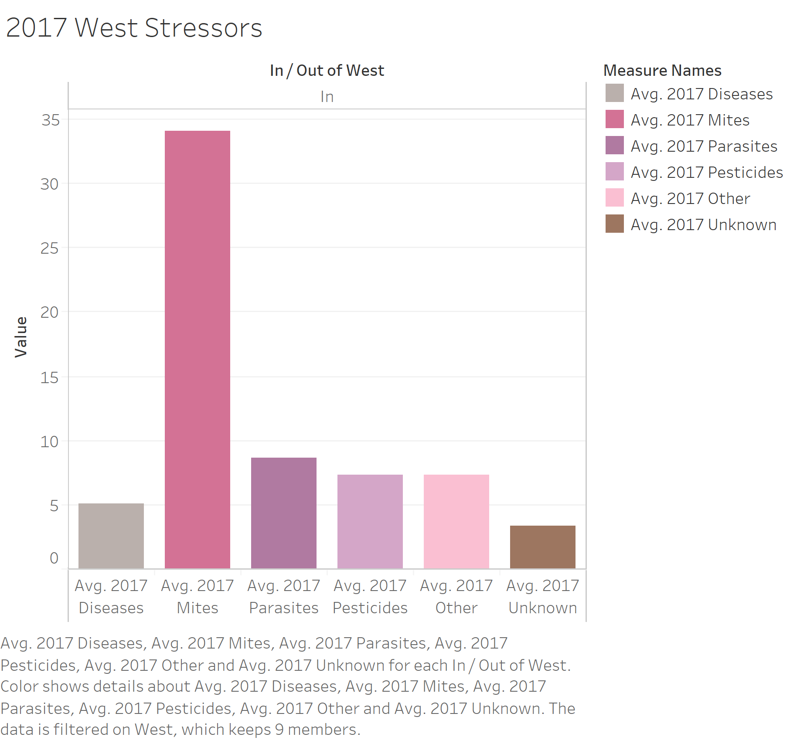
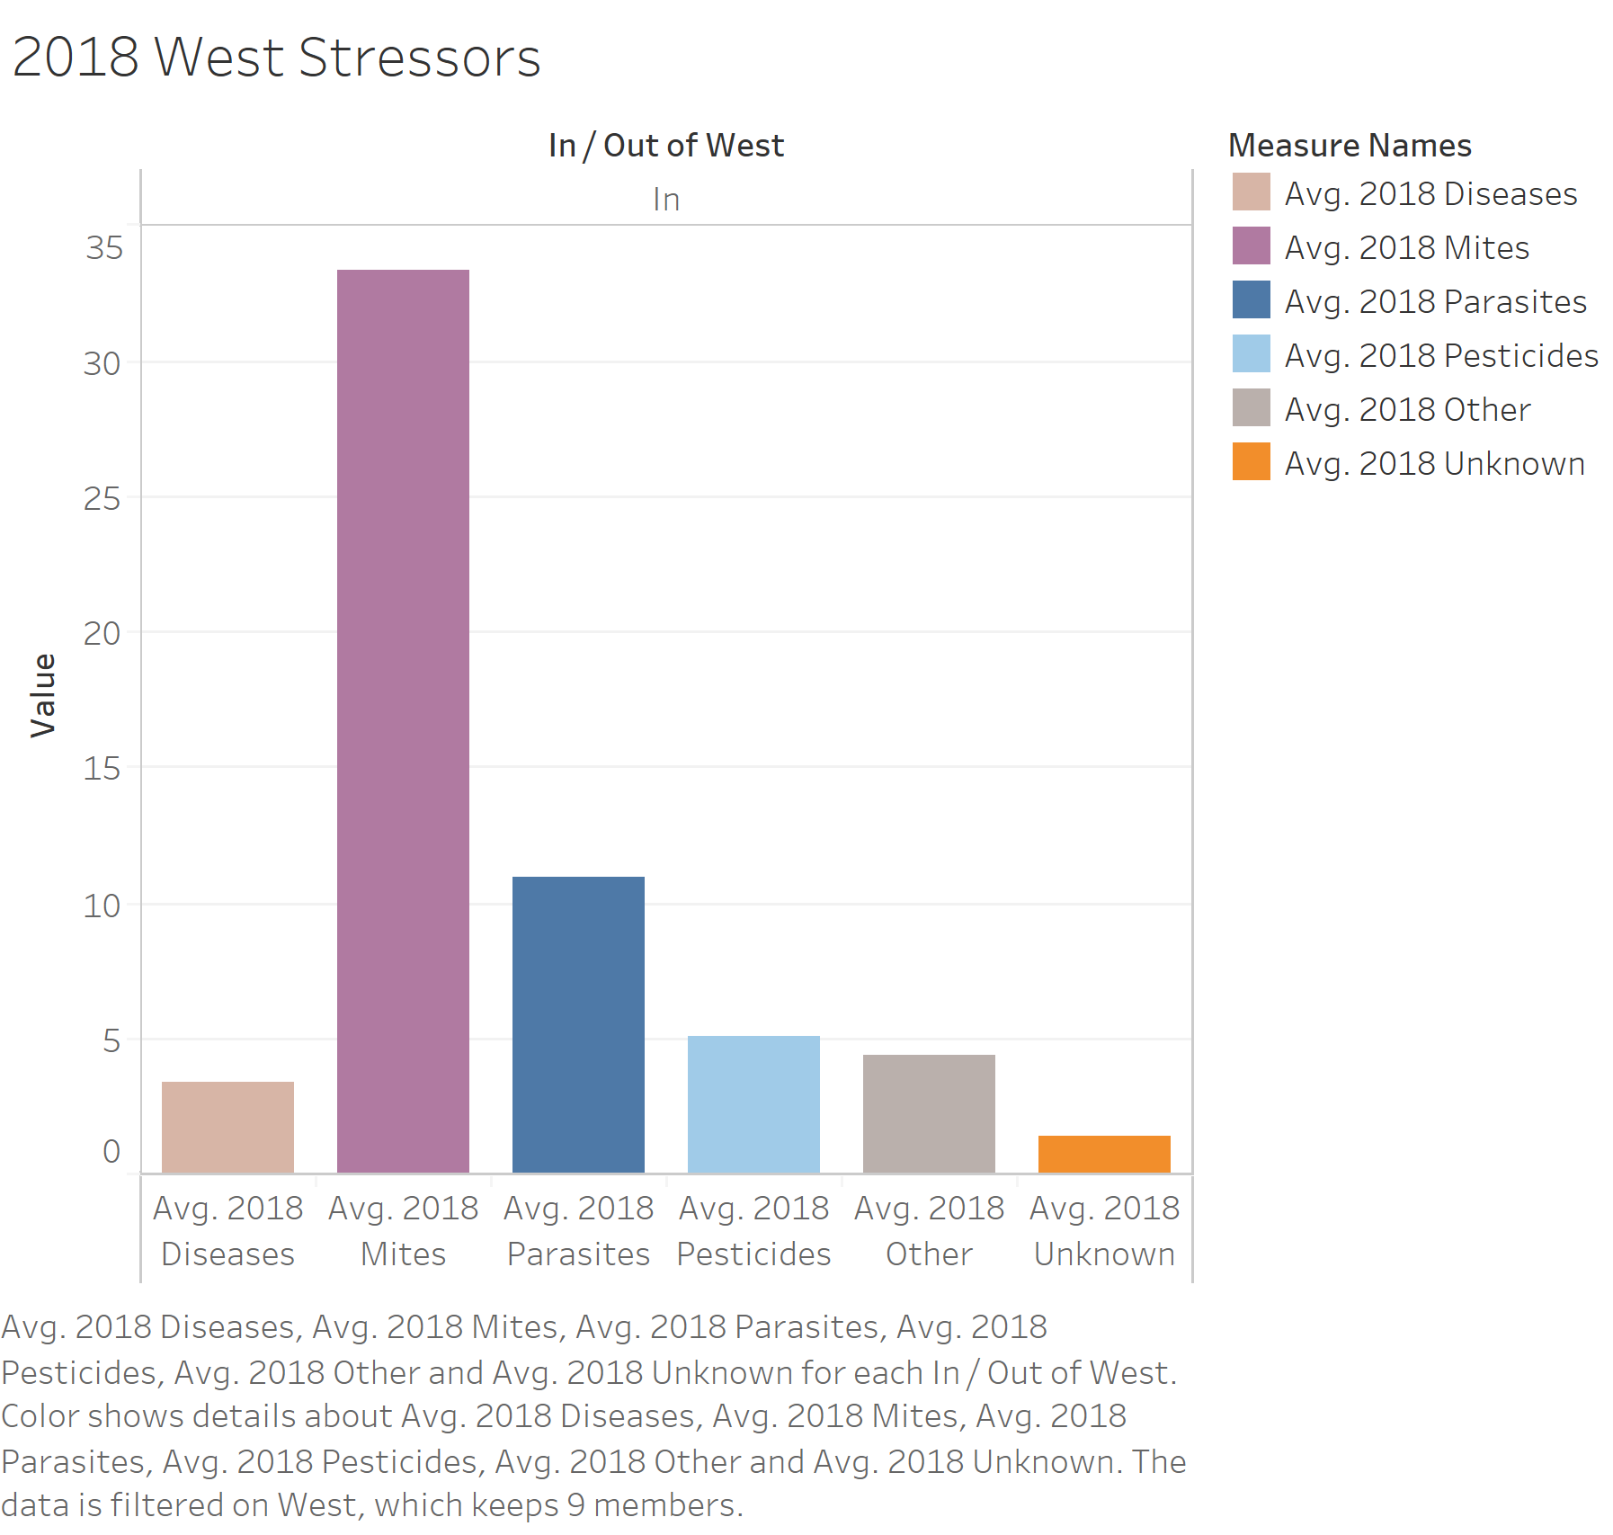
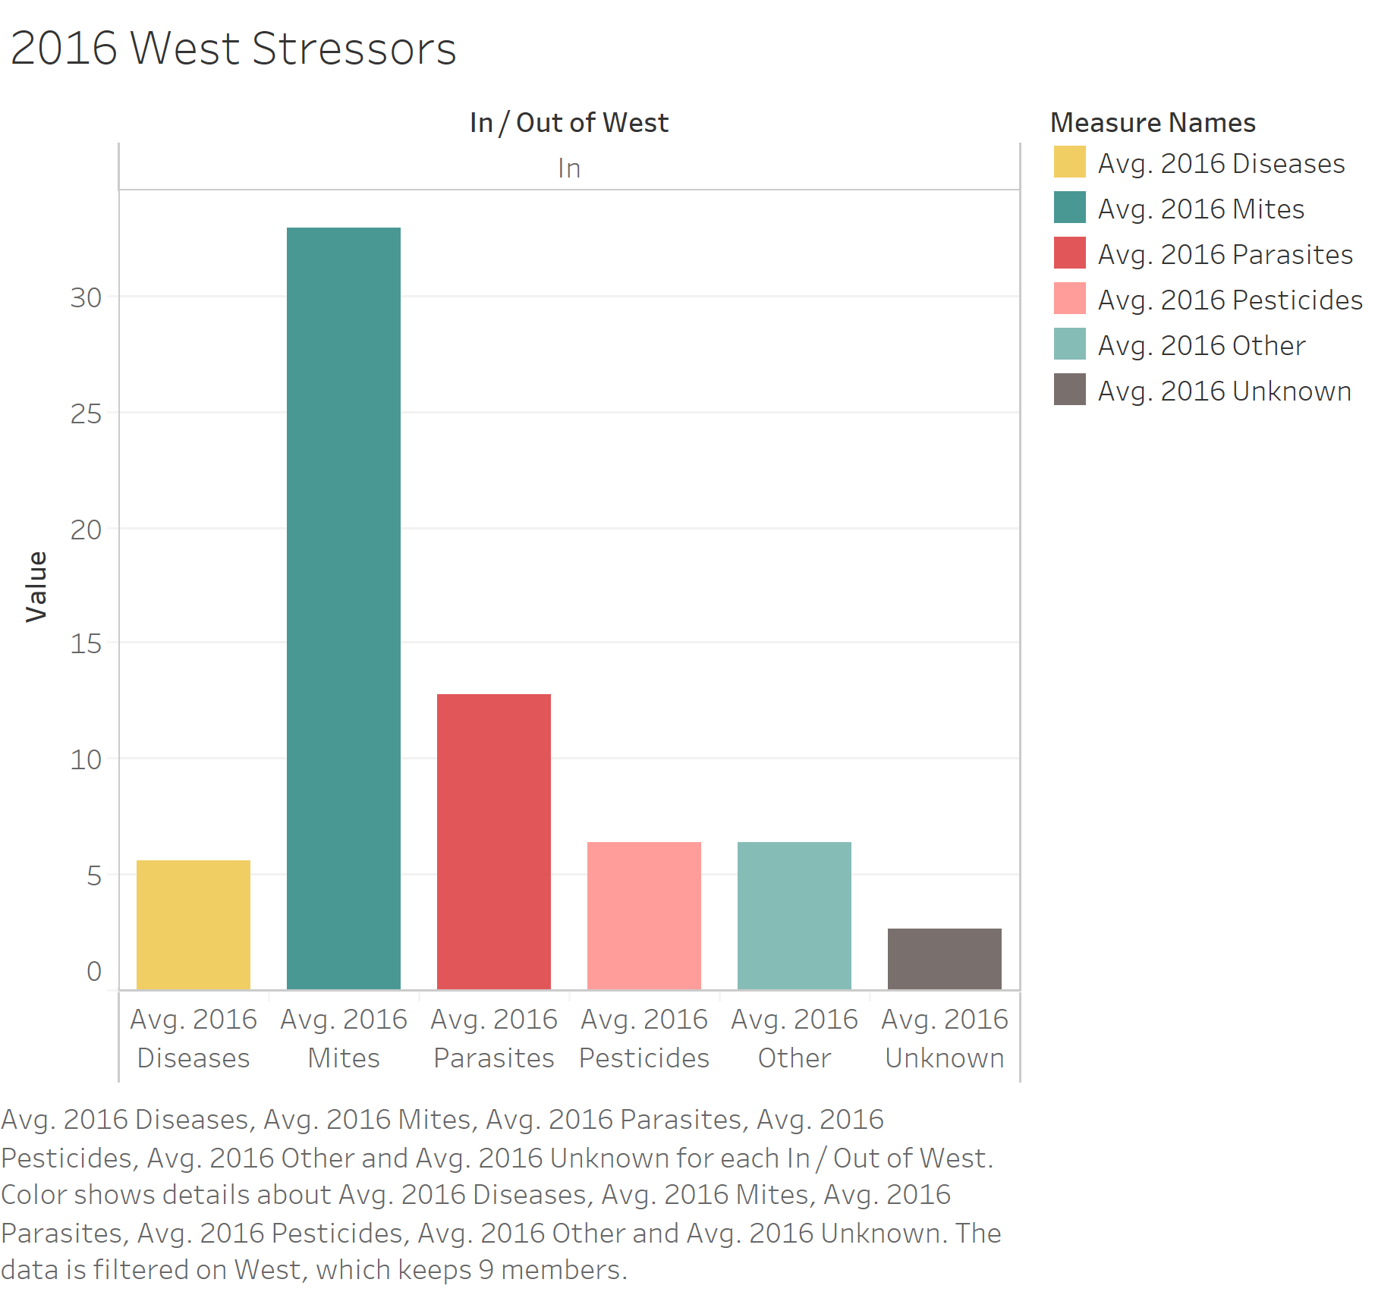
West Health Stressors 2015-2018
2015
2016
2017
2018

Slide 18
2015 Health Stressors by Region
Northeast
Southeast
Southwest
West
Midwest

Slide 19
2016 Health Stressors by Region
Northeast
Southeast
Midwest
Southwest
West

Slide 20
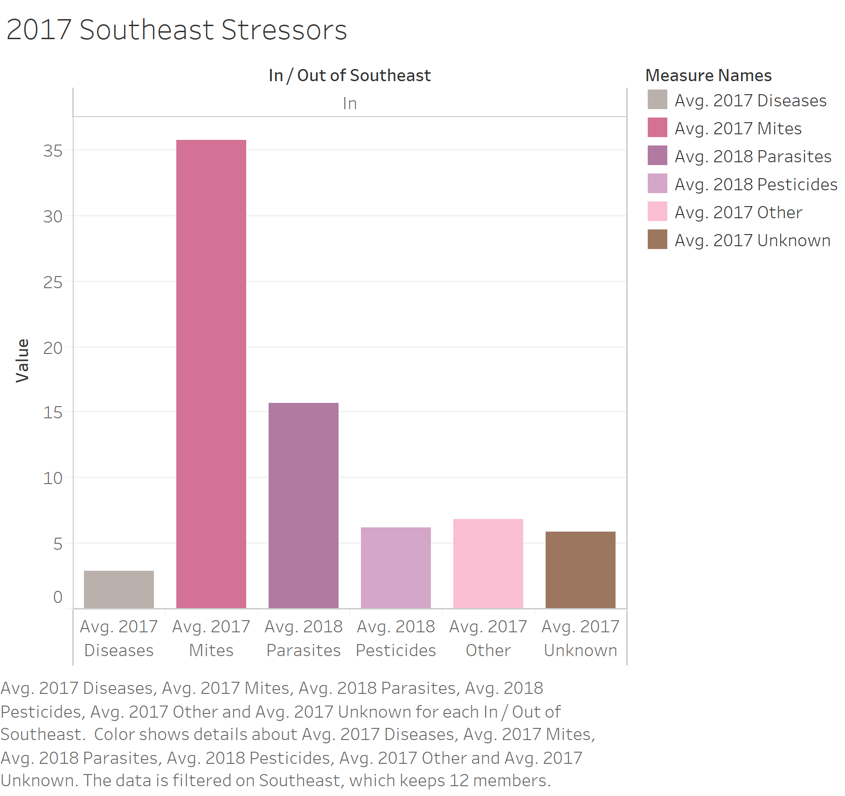
2017 Health Stressors by Region
Northeast
Southeast
Southwest
West
Midwest

Slide 21
2018 Health Stressors by Region
Northeast
Southeast
West
Midwest
Southwest

Slide 22
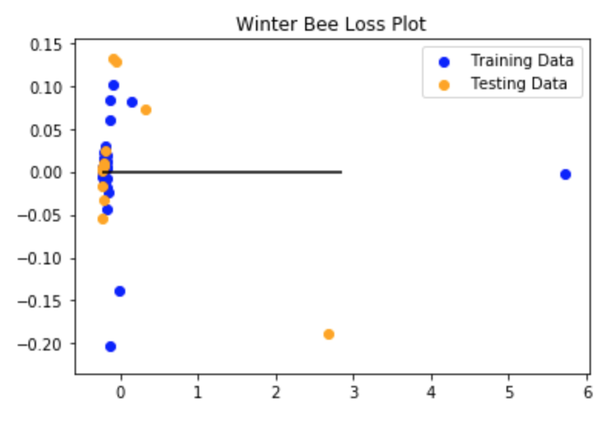
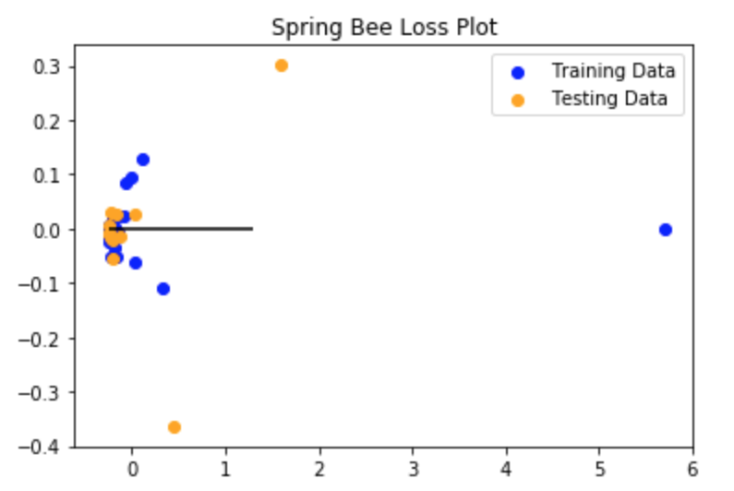
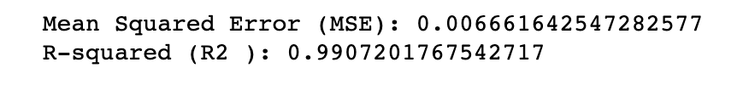
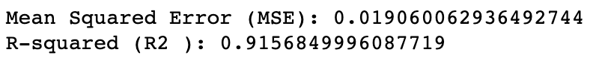
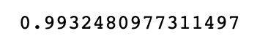
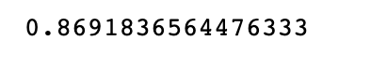
MACHINE LEARNING

Slide 23
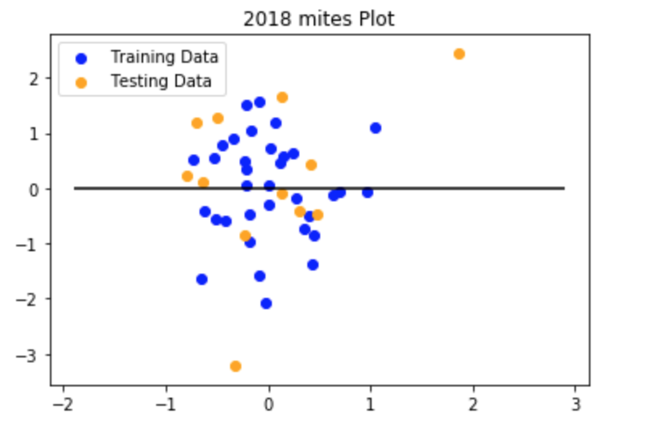
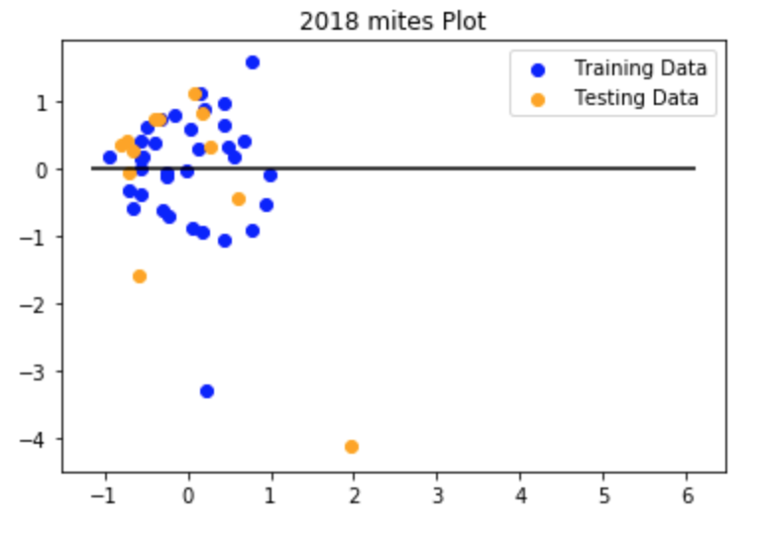
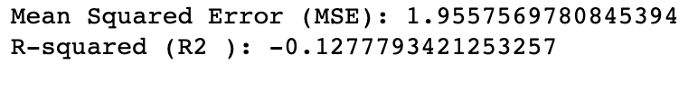
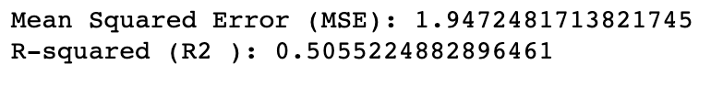
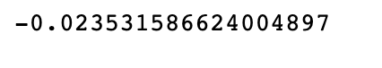
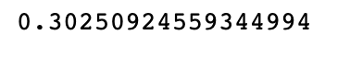
MACHINE LEARNING
2018 Mites Plot
2018 Parasites Plot

Slide 24
